Slide 1
PolliVidis
Final Presentation
CS-492 Senior Design Project
2022 Spring
Supervisor : Ercüment Çiçek
Jury Members: Shervin Arashloo, Hamdi Dibeklioğlu
Ömer Ünlüsoy
İrem Tekin
Elif Gamze Güliter
Ece Ünal
Umut Ada Yürüten

Slide 2
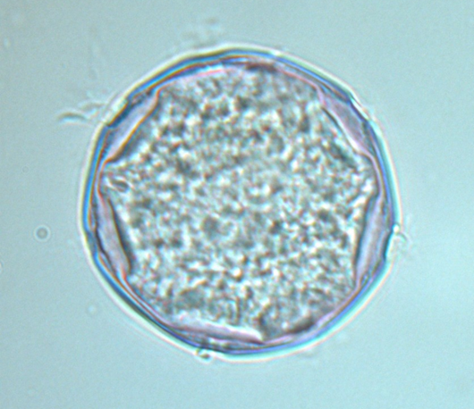
What is PolliVidis?
Pollividis is a web application in which;
pollen classification and counting can be done automatically,
academics can store and share their pollen samples, also look at other academics’ pollen samples,
allergic people can see pollen diversity with densities of where they live.

Slide 3
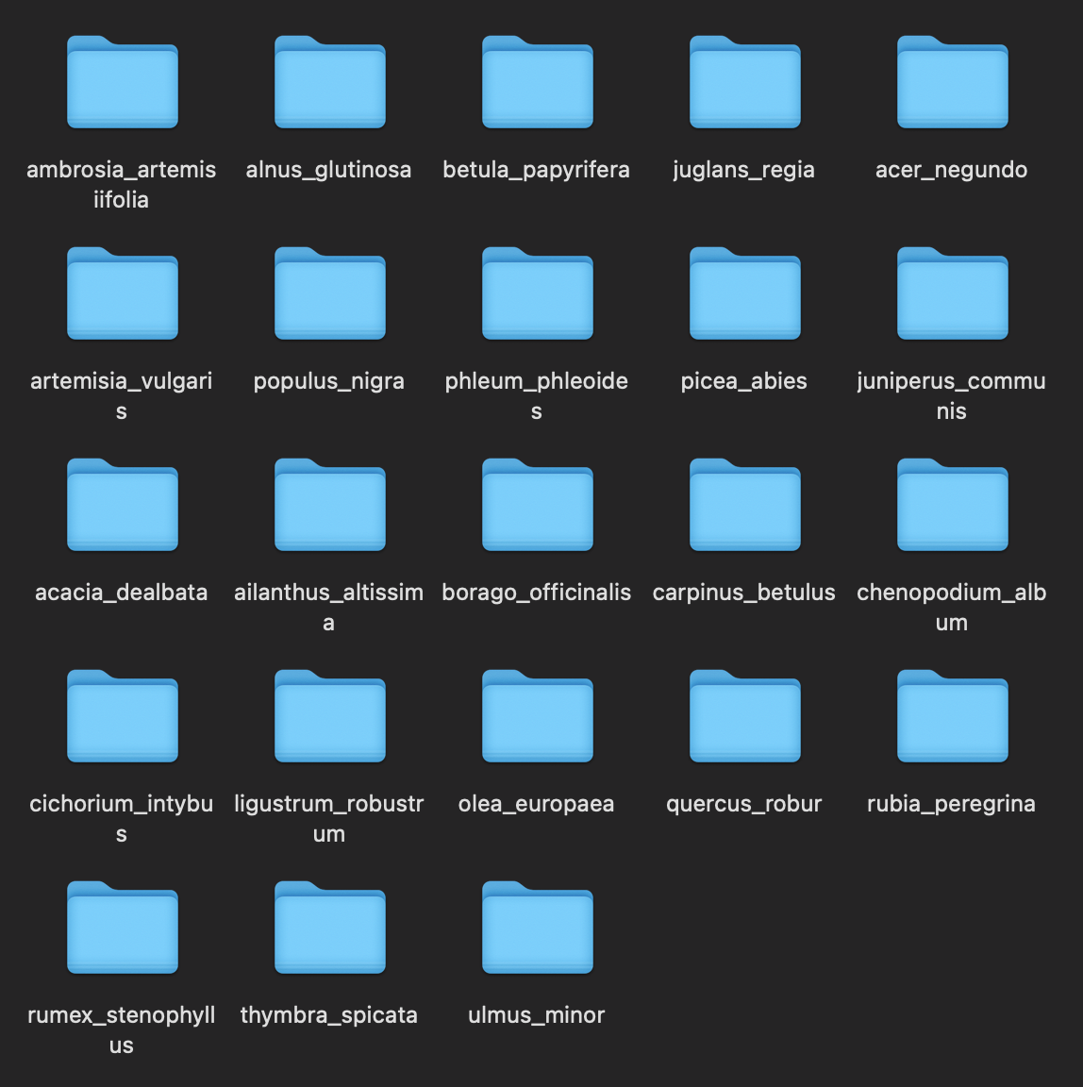
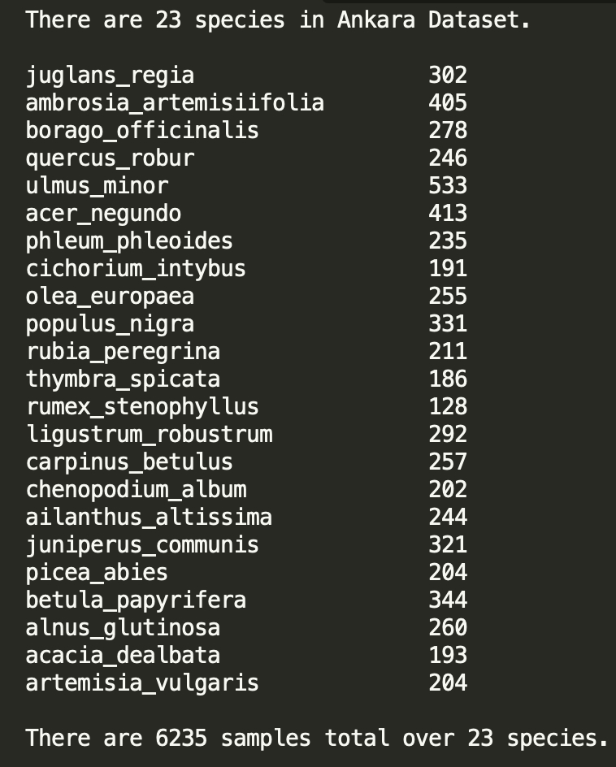
The Dataset Problem
So, we decided to
create our dataset from scratch.
Our dataset has;
more than 6000 pollen images,
23 pollen species.

Slide 4
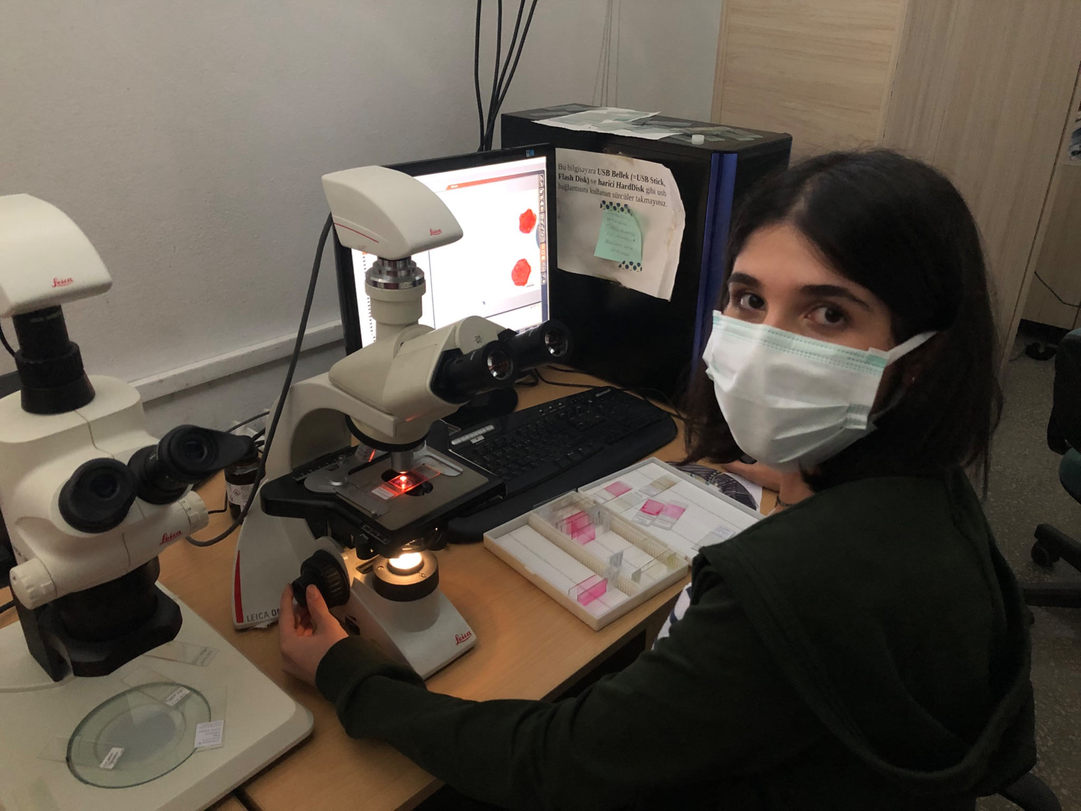
Creating Dataset
We received support from Ankara University Biology Department for this process.
We have worked at R.A. Aydan Acar’s Lab.
She provided the samples and equipment for us.
We have learned how to use a light microscope equipped with a camera and its software.

Slide 5
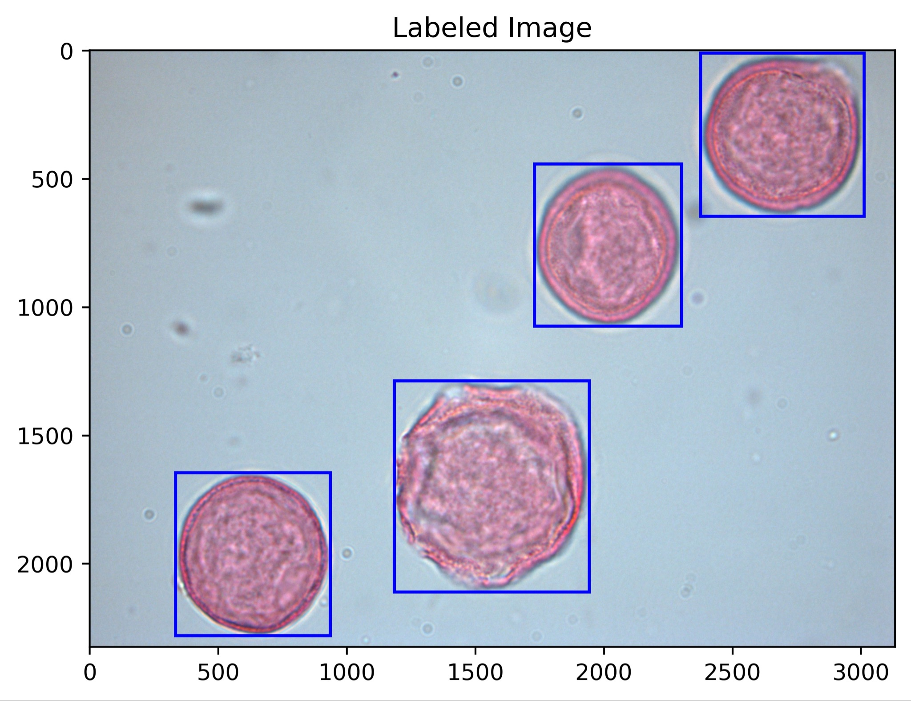
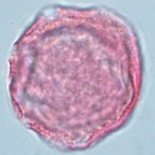
Image Processing Procedure (Pollen Extraction)
to extract single pollen images from raw dataset to train our model.
to extract single pollen images from user’s sample image to forward it to the model.

Slide 6
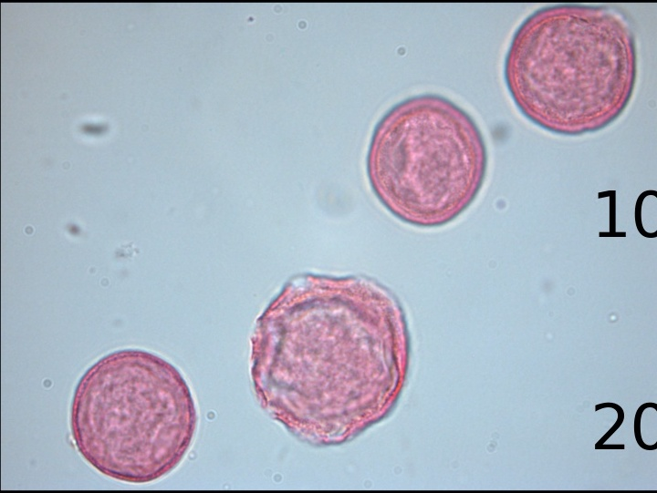
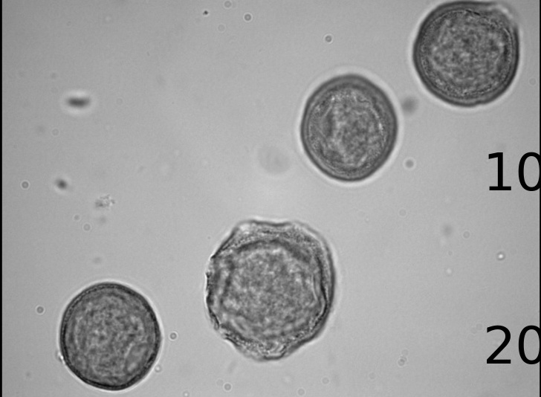
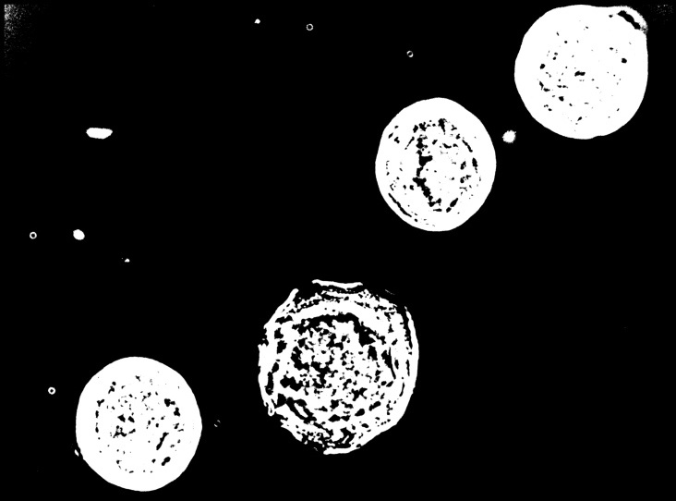
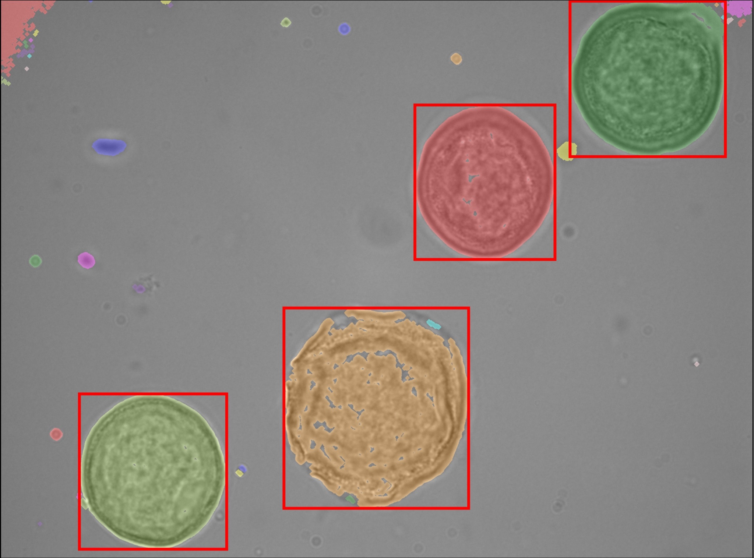
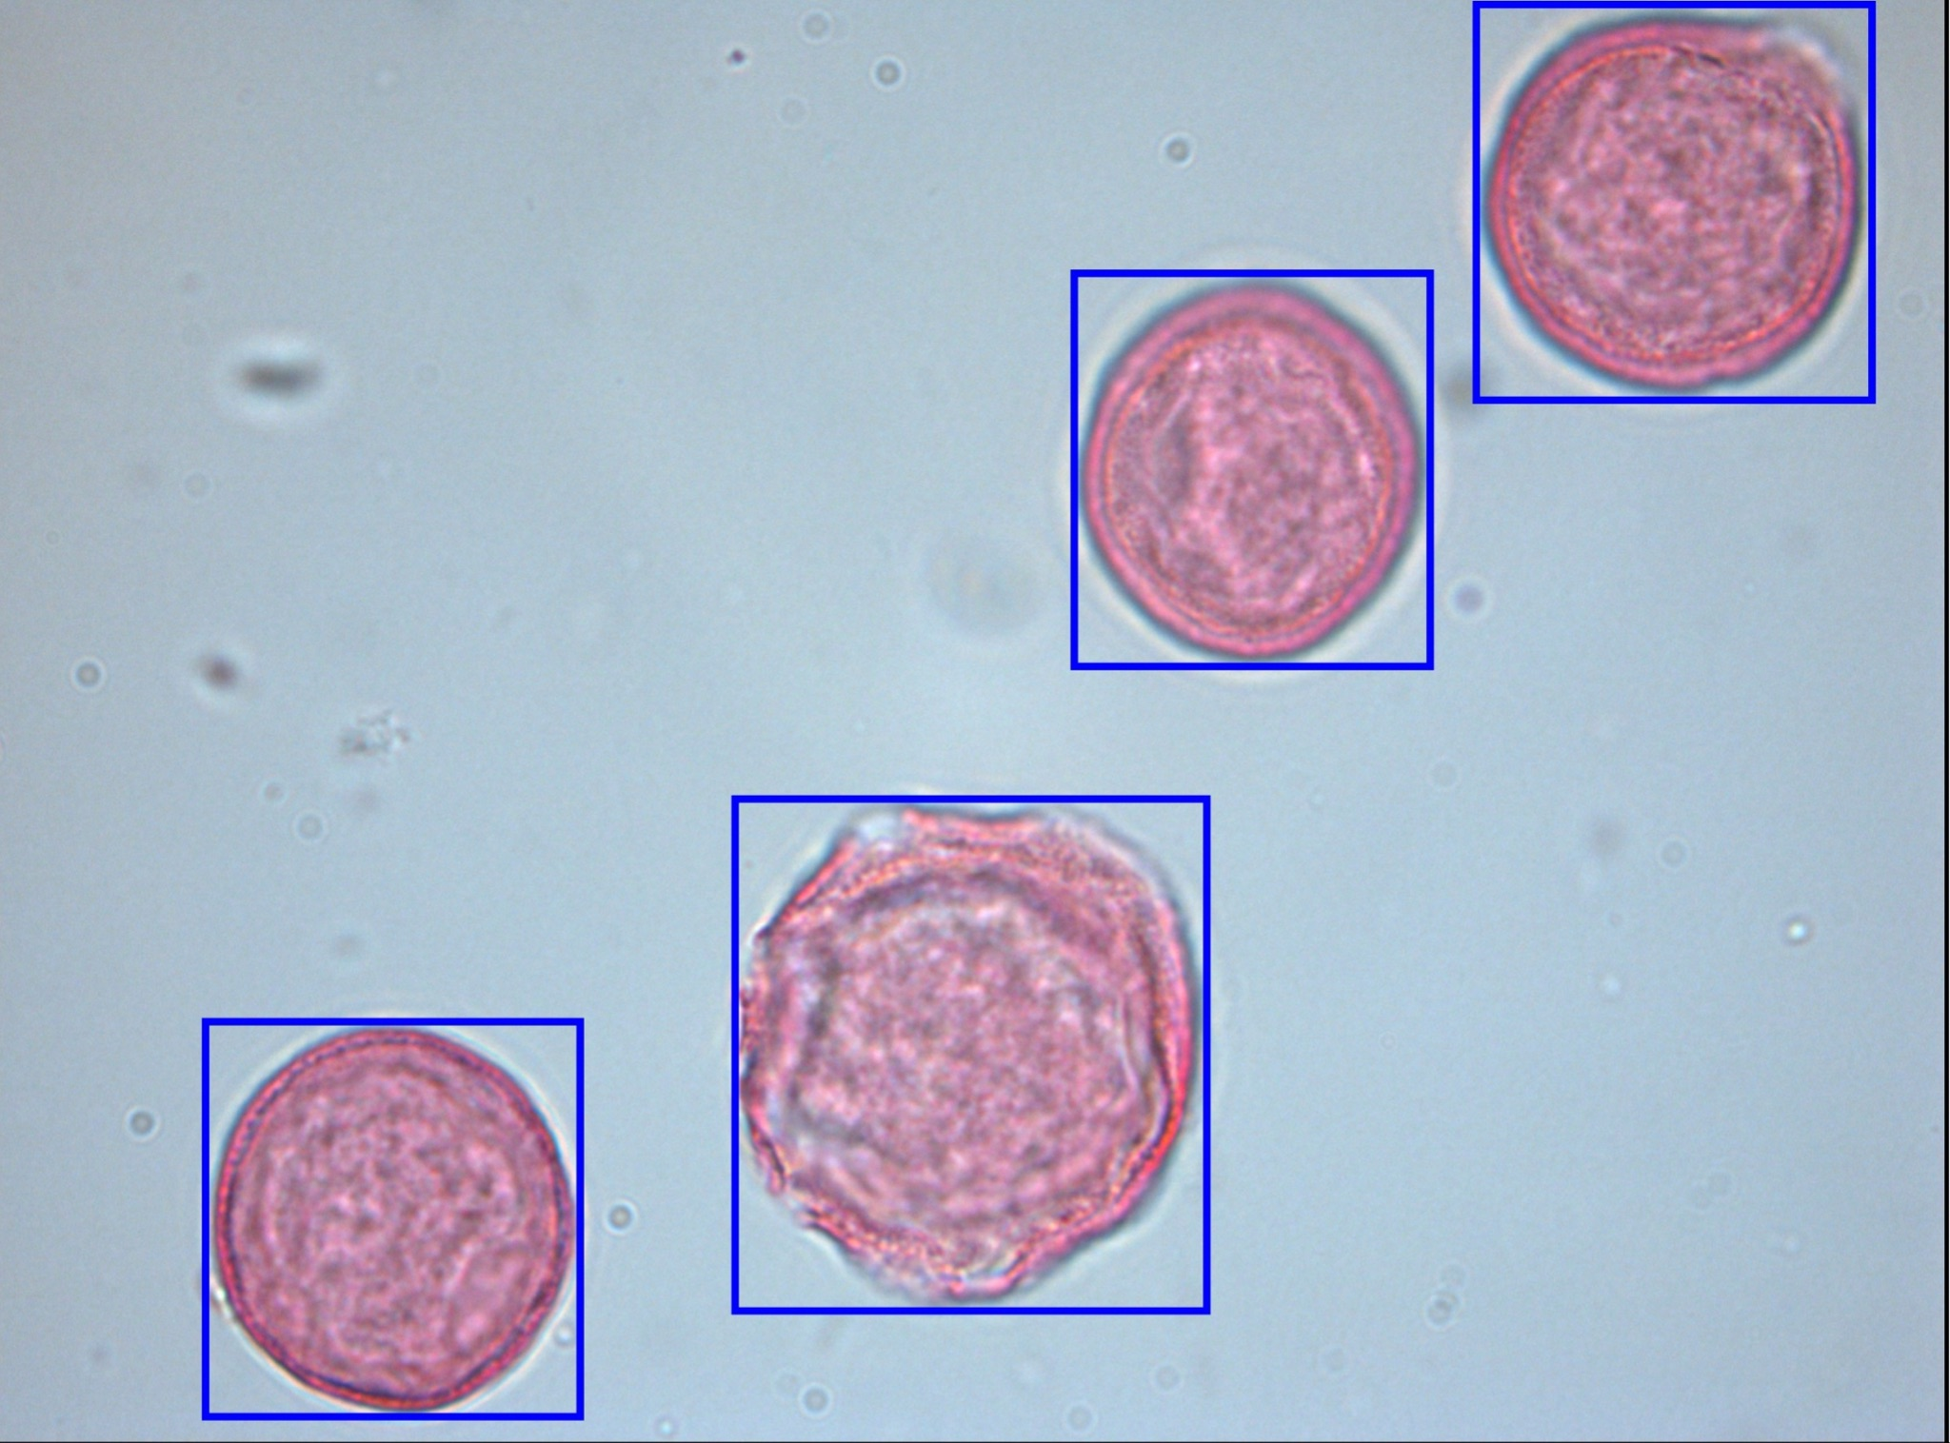
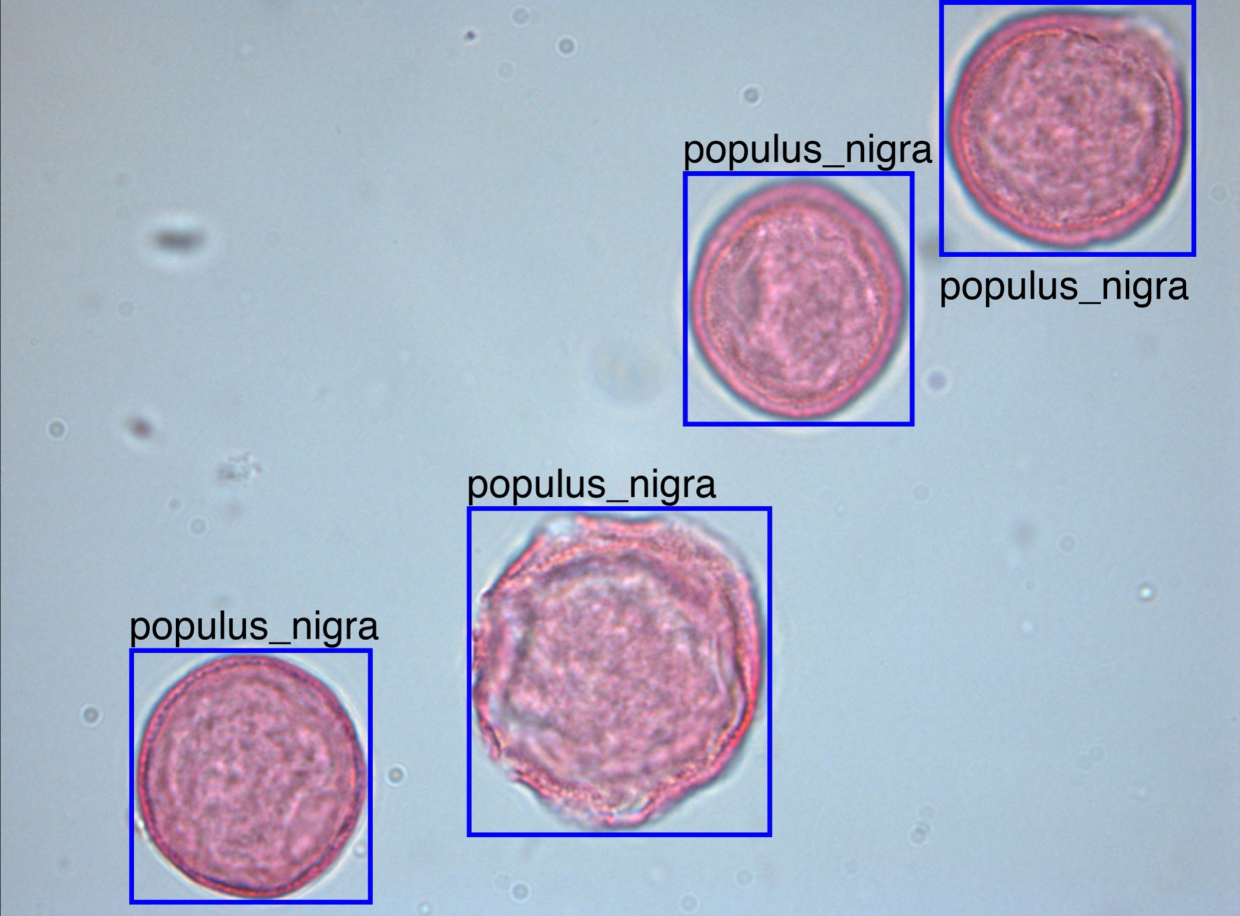
The Procedure
Labeled pollens are cropped and forwarded to the CNN model one-by-one.
CNN
Model
Morphology Sequence and thresholding are applied to separate regions.
predictions
From the labeled sample image, original image is labeled with the predictions of CNN model.
Sample image turns into gray scale image for thresholding.
Thresholded image is passed to the labeling procedure to label each region.

Slide 7
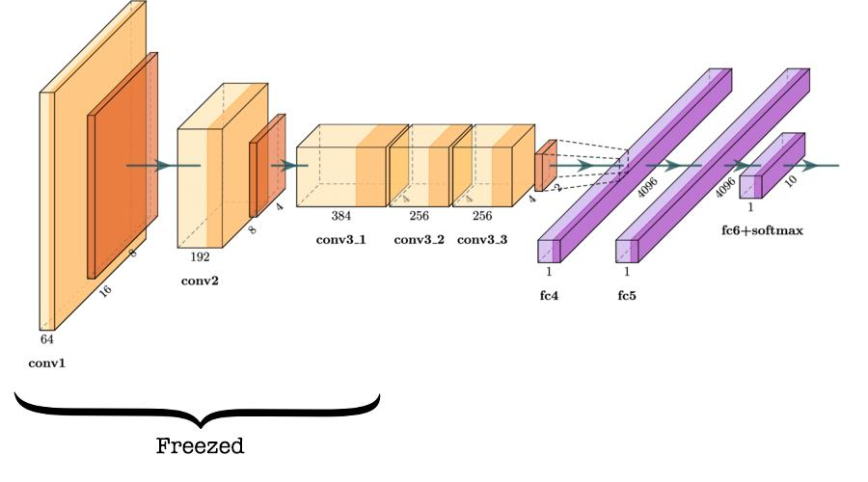
CNN (AlexNet based)
Transfer Learning with pre-trained AlexNet architecture
Partially-freezed the model for fine tuning.
Notes:
AlexNet image (half freezed)

Slide 8
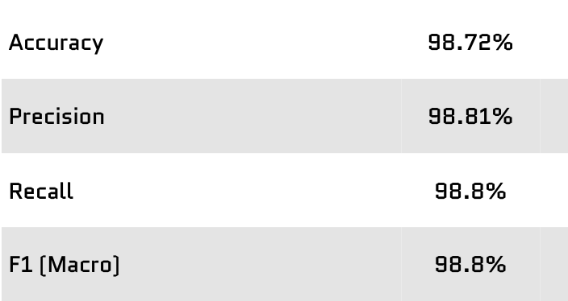
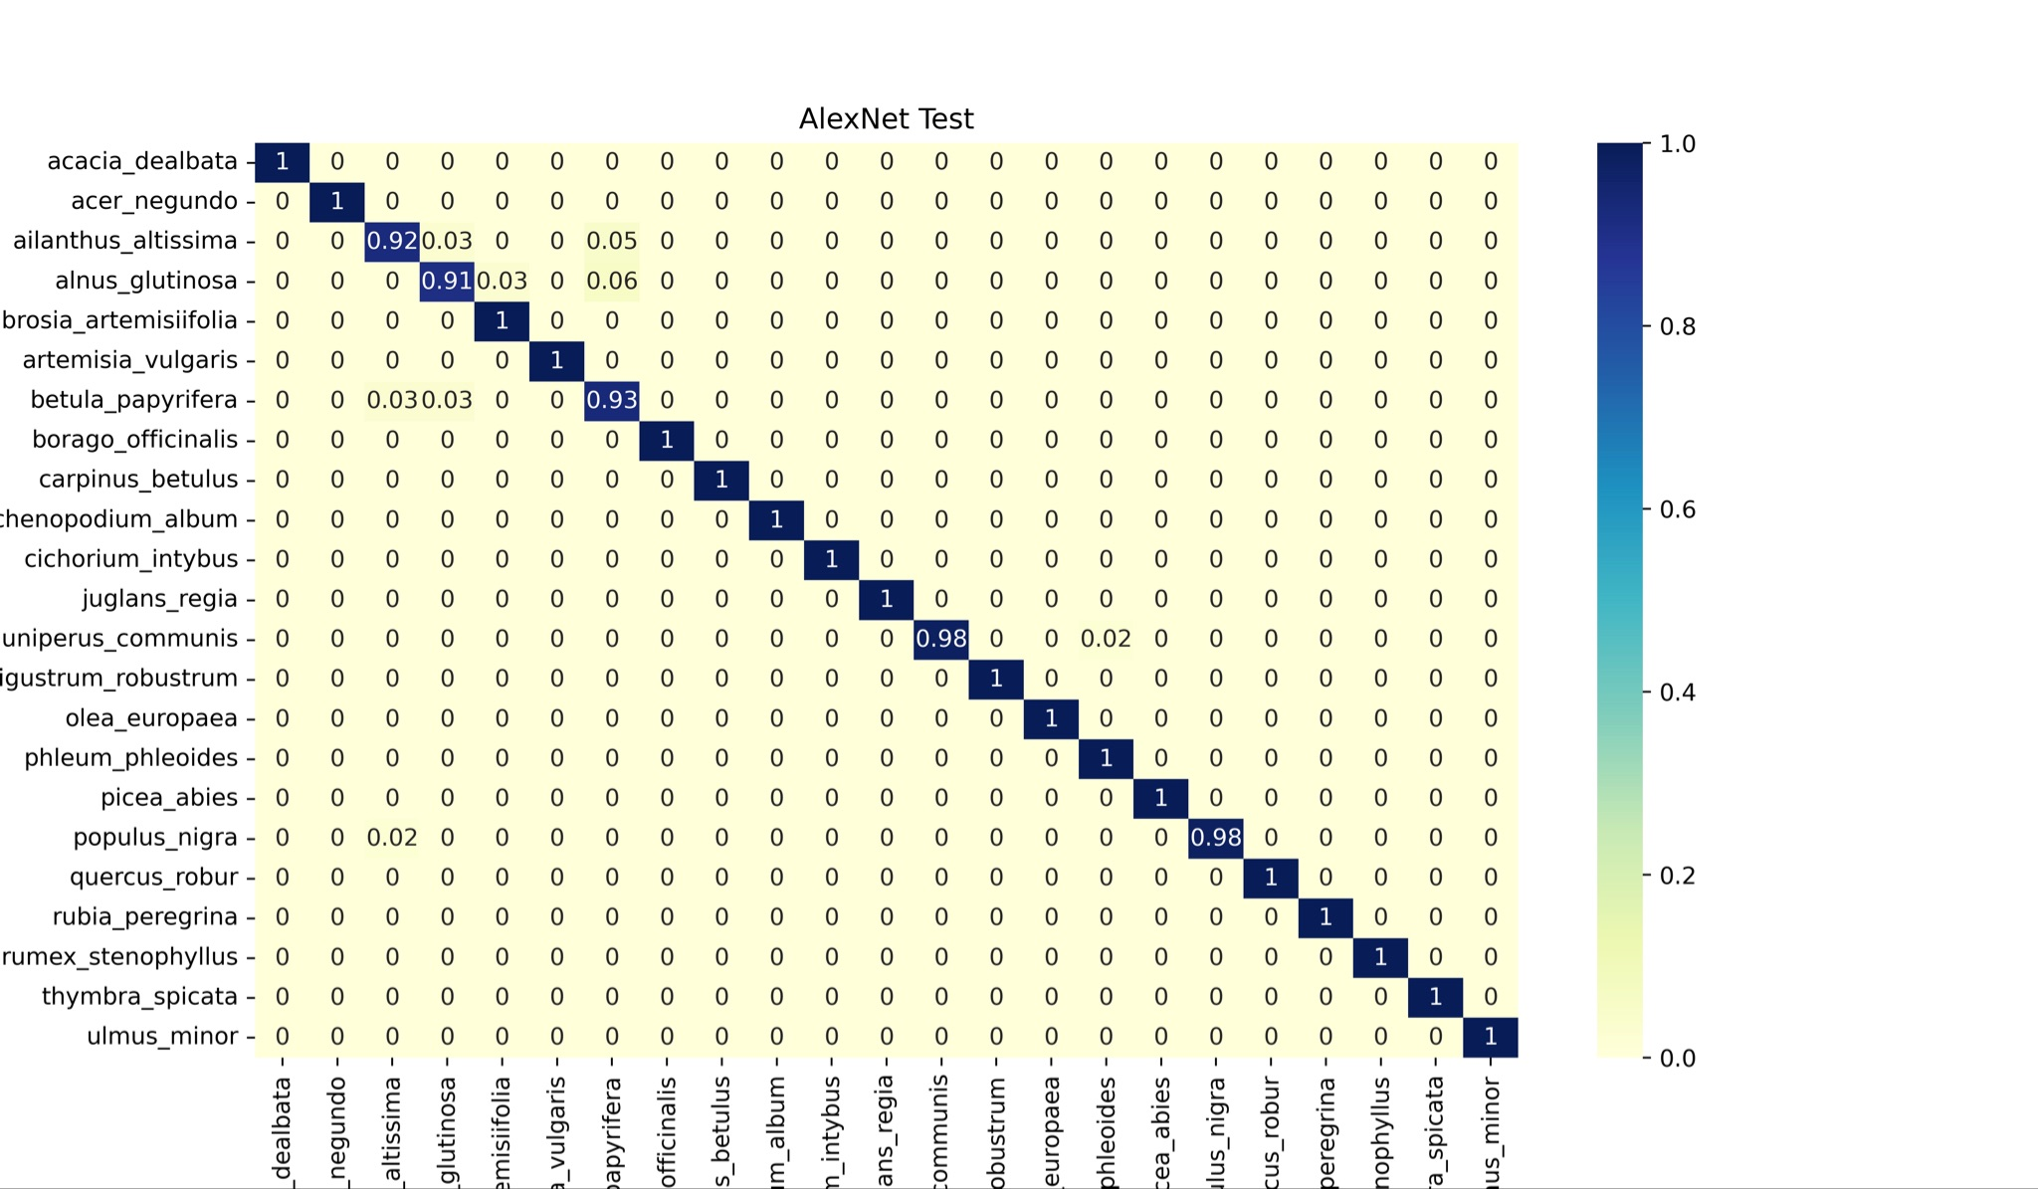
CNN Performance
Metrics
After testing procedure following performance metrics are achieved.
Notes:
AlexNet image (half freezed)

Slide 9
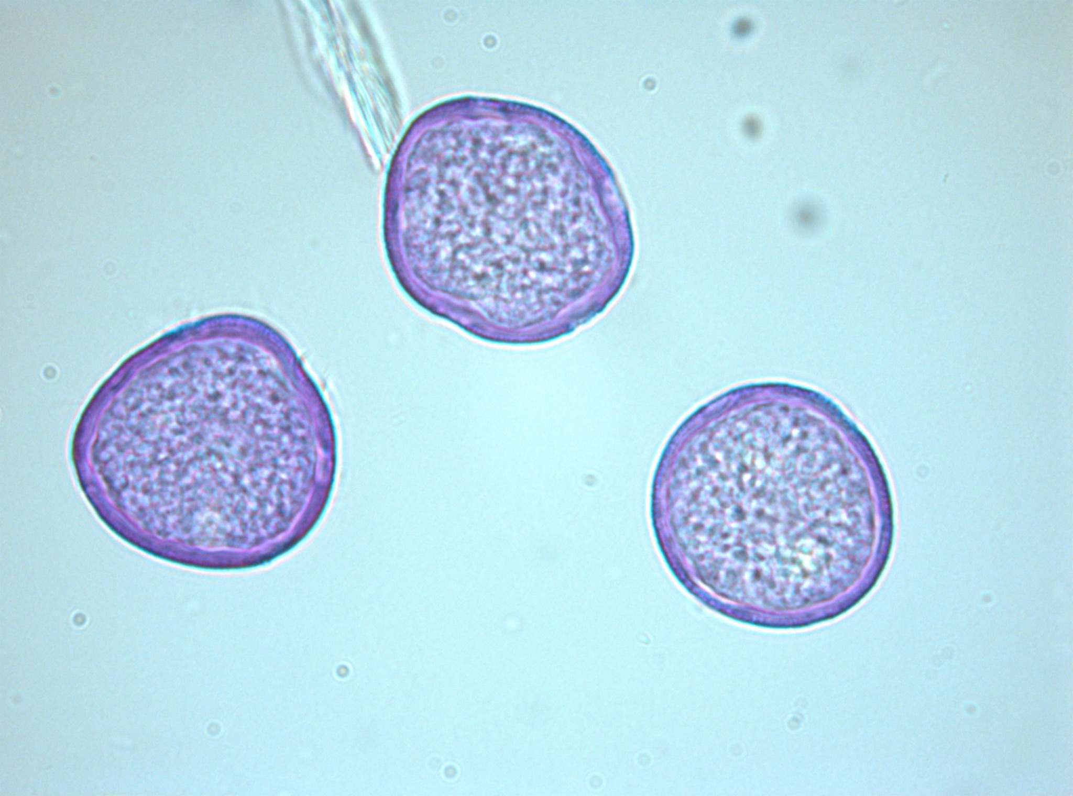
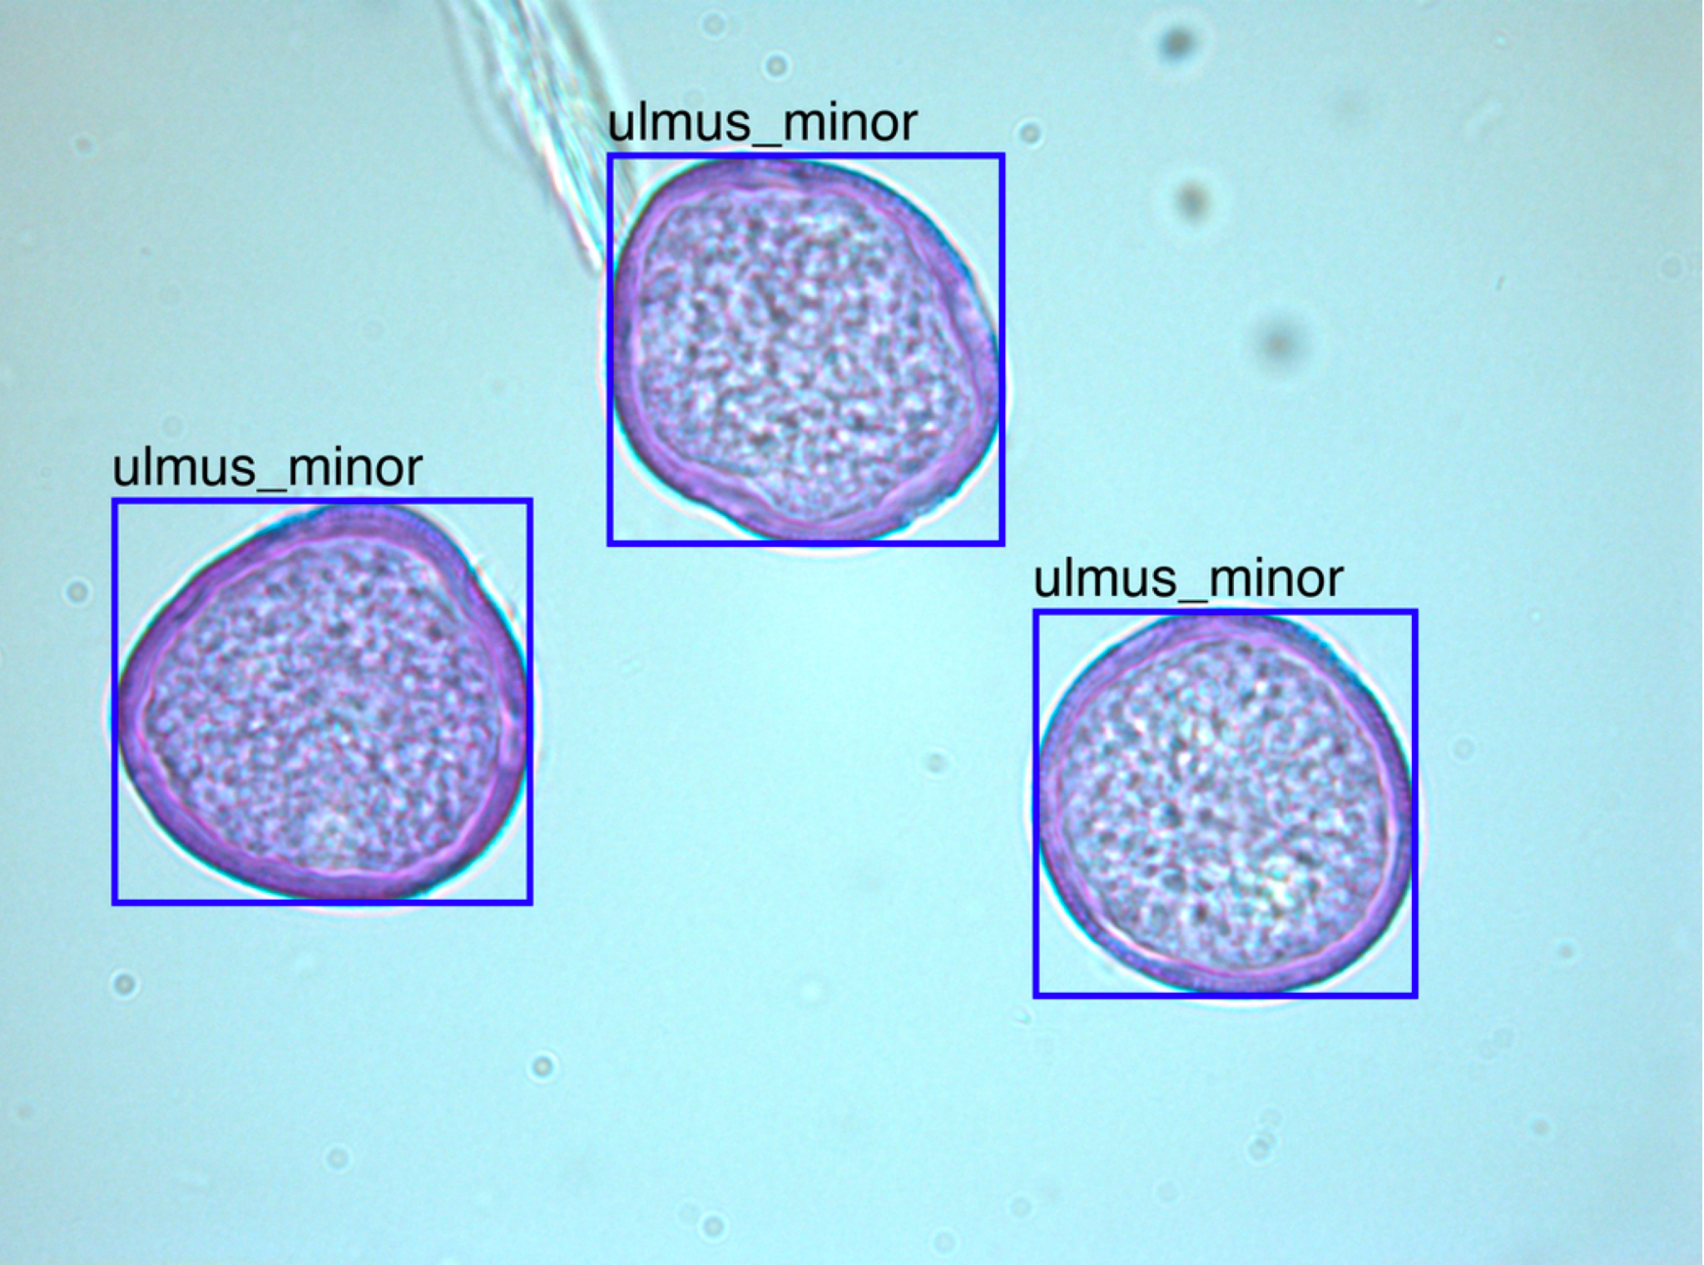
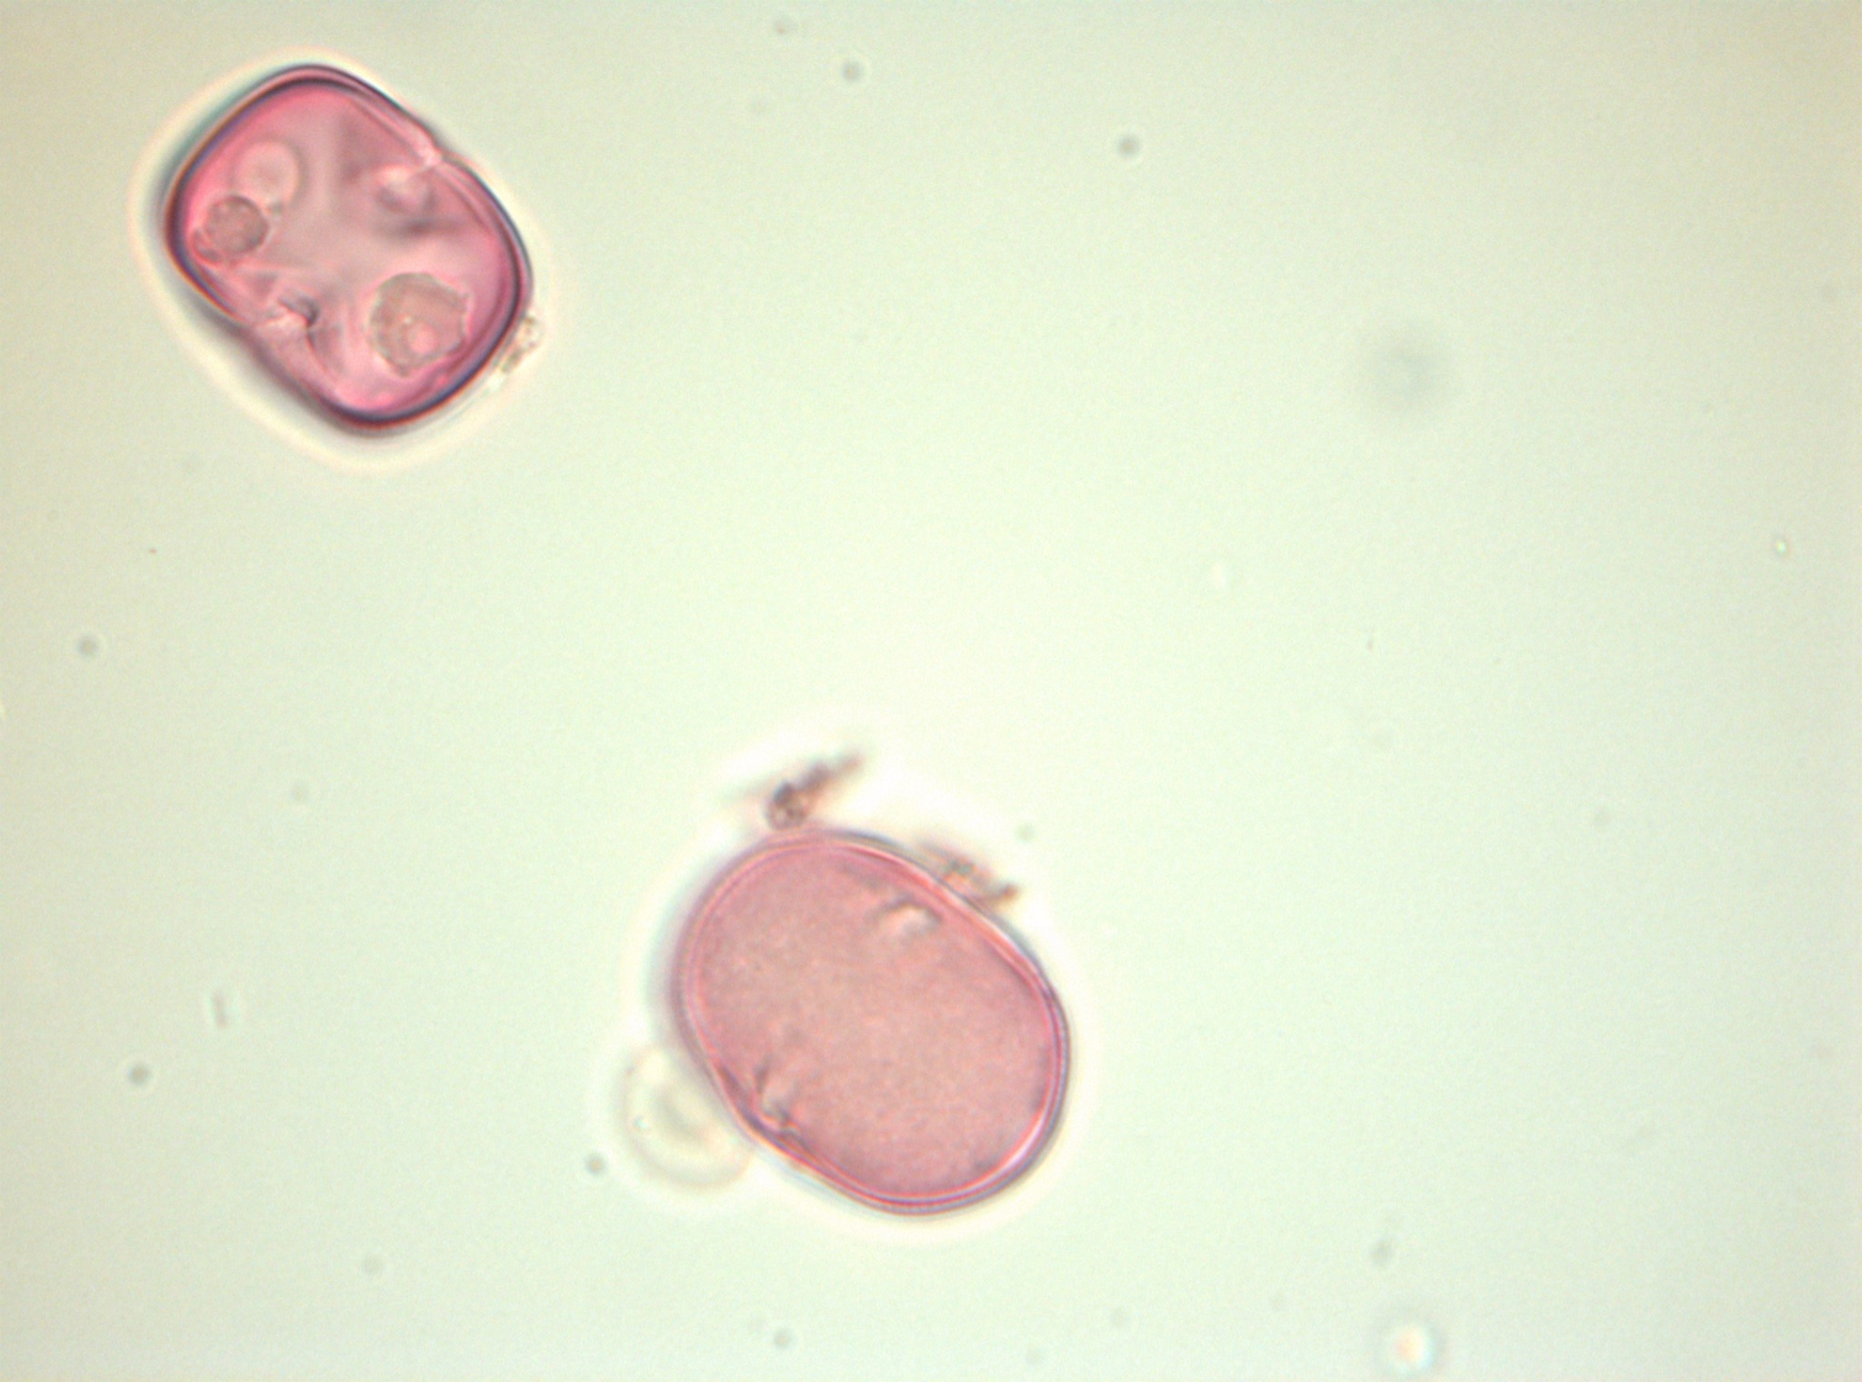
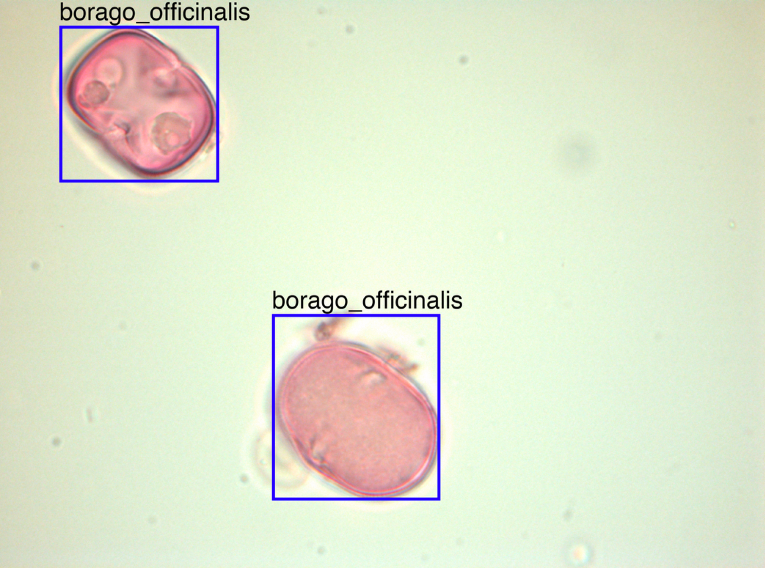
CNN
Analysis
Examples
Notes:
AlexNet image (half freezed)

Slide 10


Front-end Implementation
React.js
Functional component based top-down approach
Material UI
Google Maps API
Geocode to get the current location of the user

Slide 11

Database Implementation
MySQL database management system.
Connected to back-end via MariaDB
Server is run on Bilkent Dijkstra

Slide 12


Back-end Implementation
Python Django and REST Framework is used for the back-end.
Google Firebase Storage service used for image transfer.

Slide 13
Demo

Slide 14
Thanks for Listening

Slide 15
Extra Slides

Slide 16
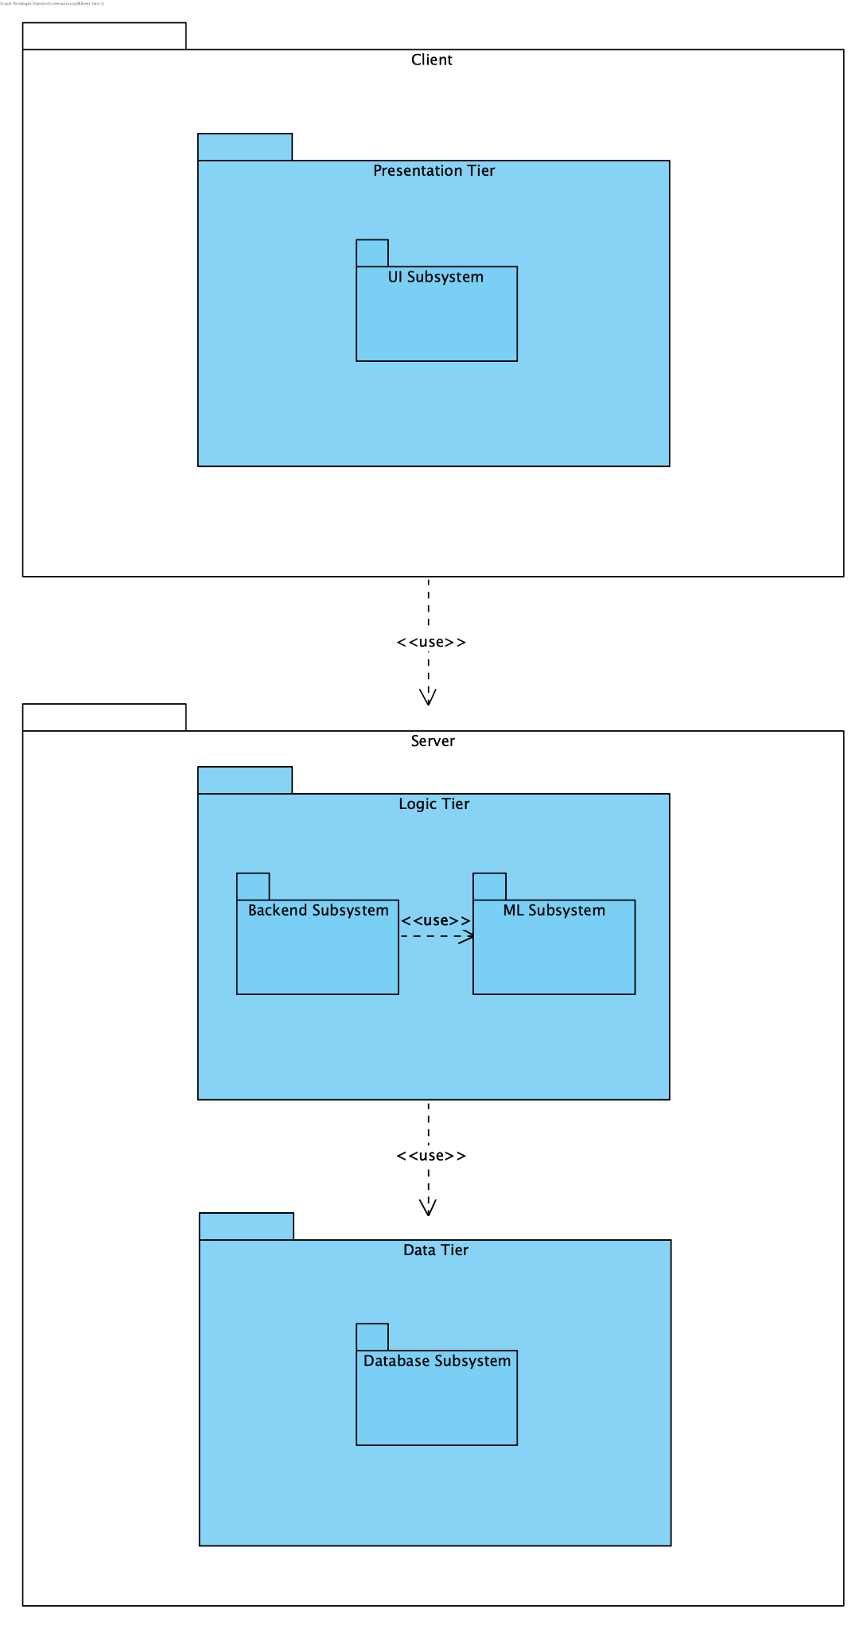
Subsystem Decomposition
System composition of PolliVidis mimics 3-Tier Client/Server Architecture since it is a web application.
On the client side, PolliVidis implements the Presentation Tier which holds the UI Subsystem.
On the server side of the system, PolliVidis implements Logic and Data Tiers. In the Logic Tier, there are two subsystems, namely Backend Subsystem and ML Subsystem.
On the Data Tier, there is only one subsystem namely, Database Subsystem.

Slide 17
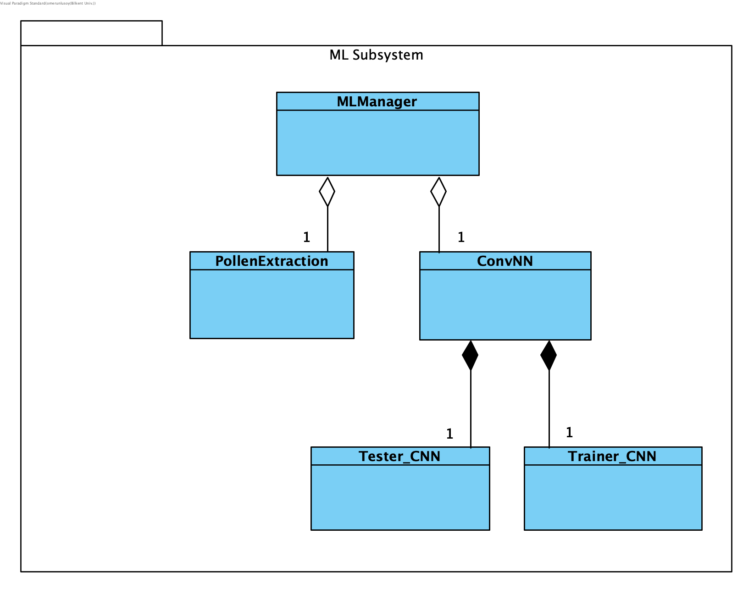
ML Subsystem
ML Subsystem is the core of PolliVidis.
Implements two main functionalities; pollen extraction from the sample image, and pollen classification.

Slide 18
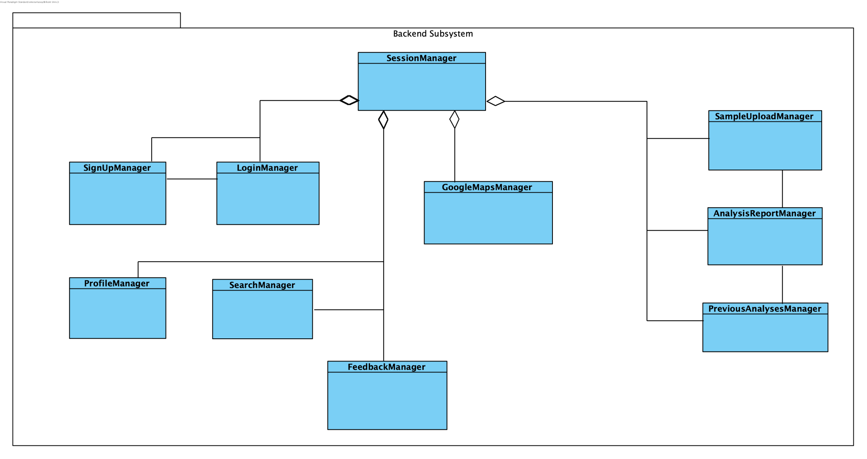
Backend Subsystem
Backbone of the PolliVidis which connects all other subsystems.
It directs user requests coming from the client side to the Data Tier.
This subsystem manages ML Subsystem to extract pollen images from the sample image and analyze them one by one. It returns the analyses to UI Subsystem.

Slide 19
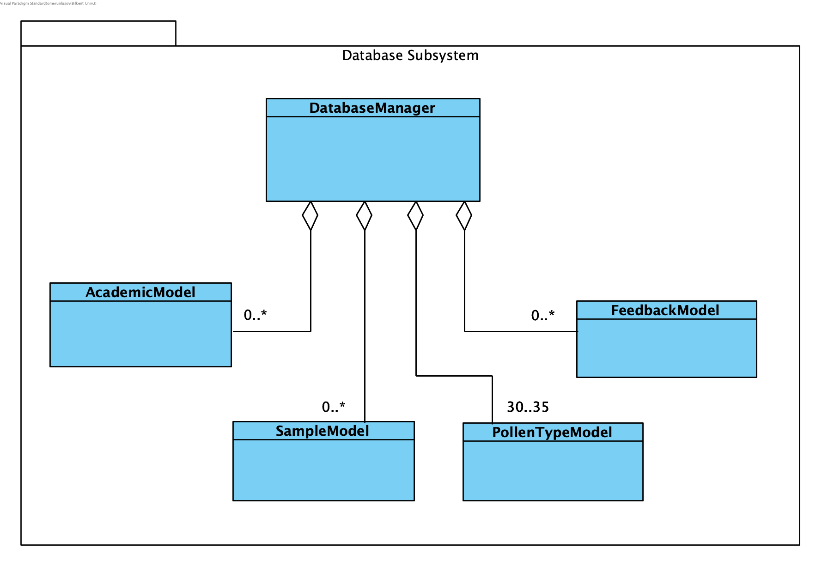
Database Subsystem
Database Subsystem handles database interactions of PolliVidis.
This subsystem is driven by the Backend Subsystem by its pre-implemented queries.
The database of PolliVidis is mainly for pollen samples uploaded by users.

Slide 20
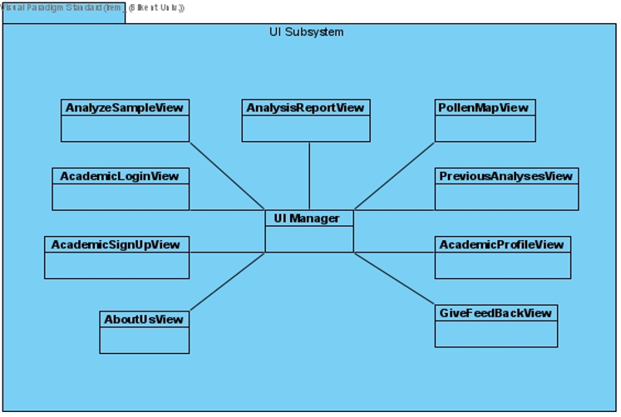
UI Subsystem
This subsystem manages user interface components such as pages and user interactions.
This subsystem sends requests to the server and shows the response to the user.

Slide 21
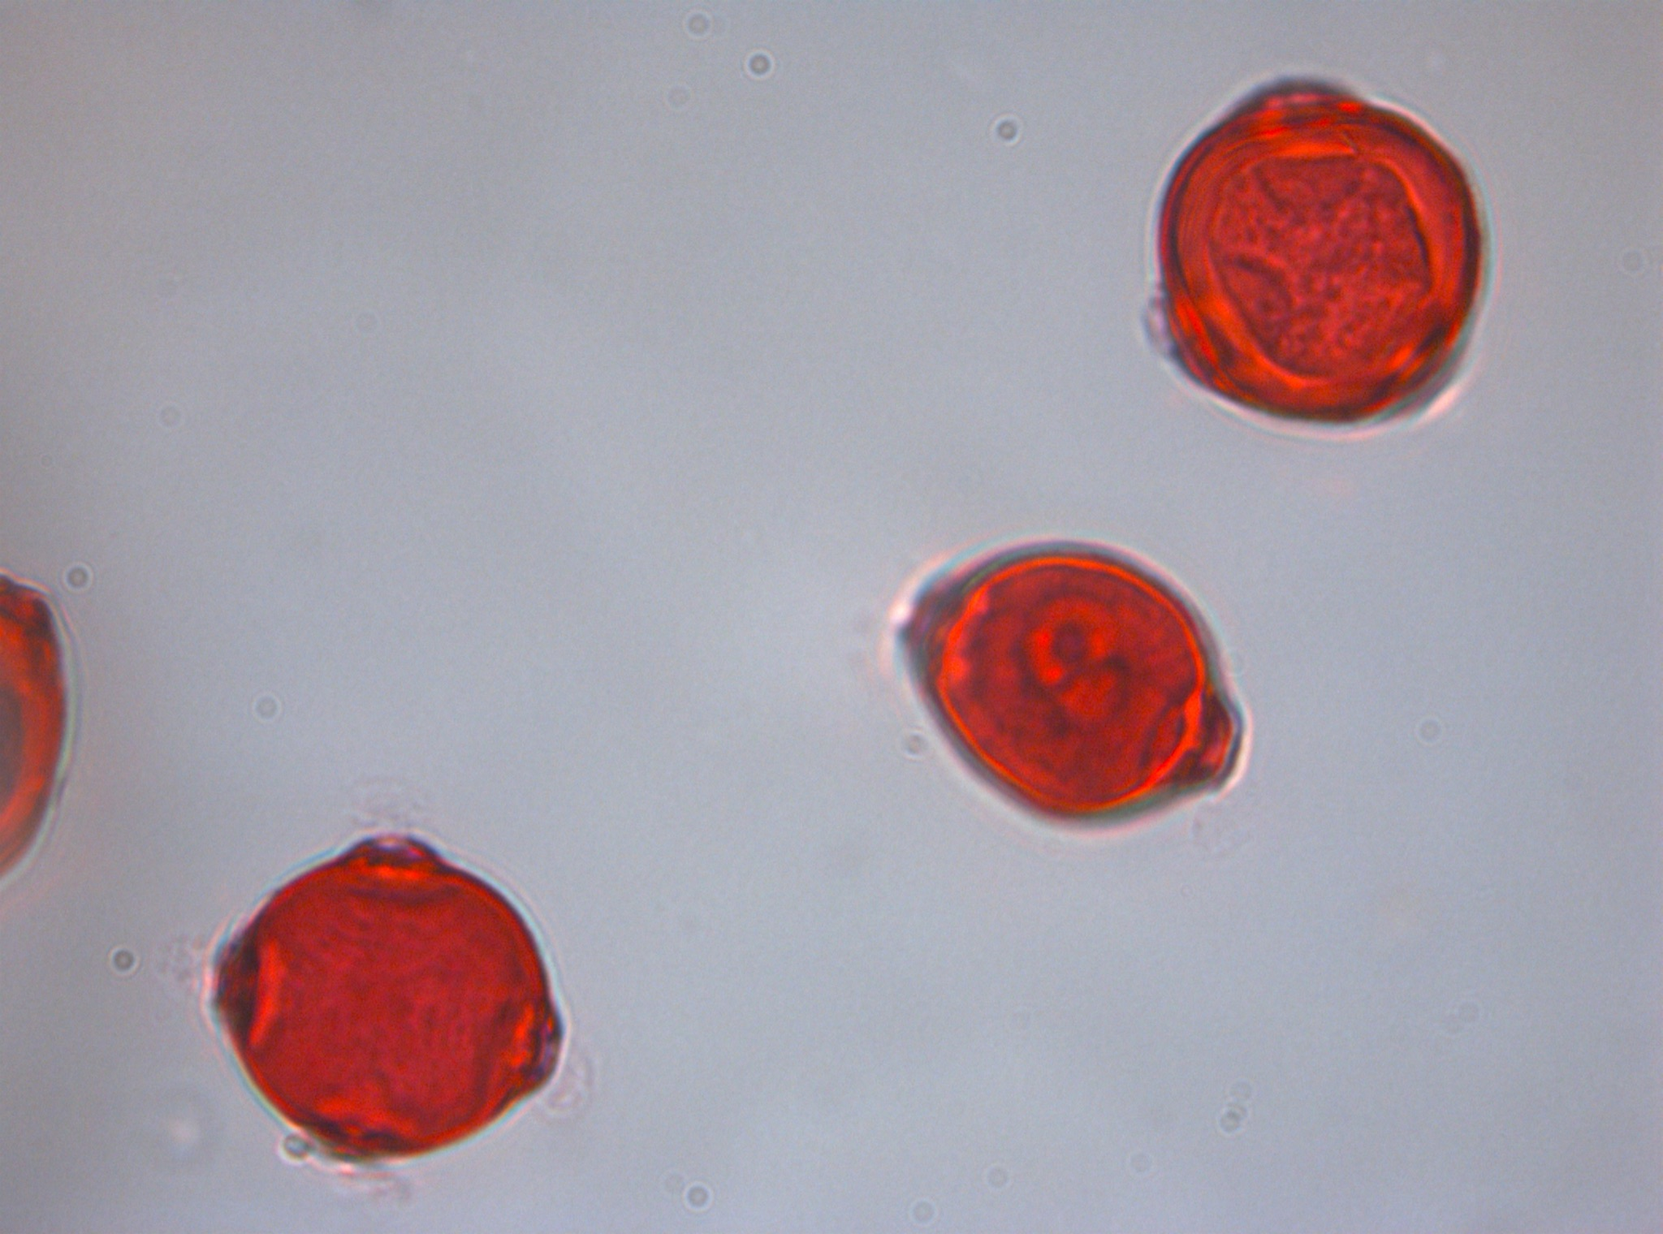
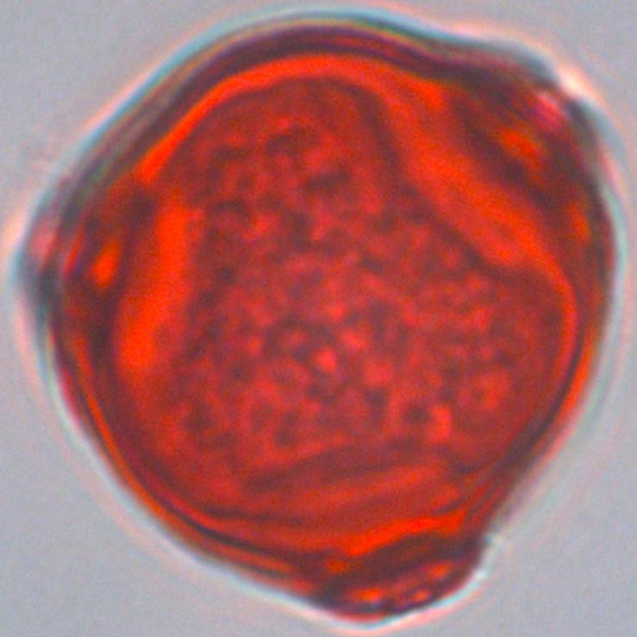
Example Pollen Extraction

Slide 22
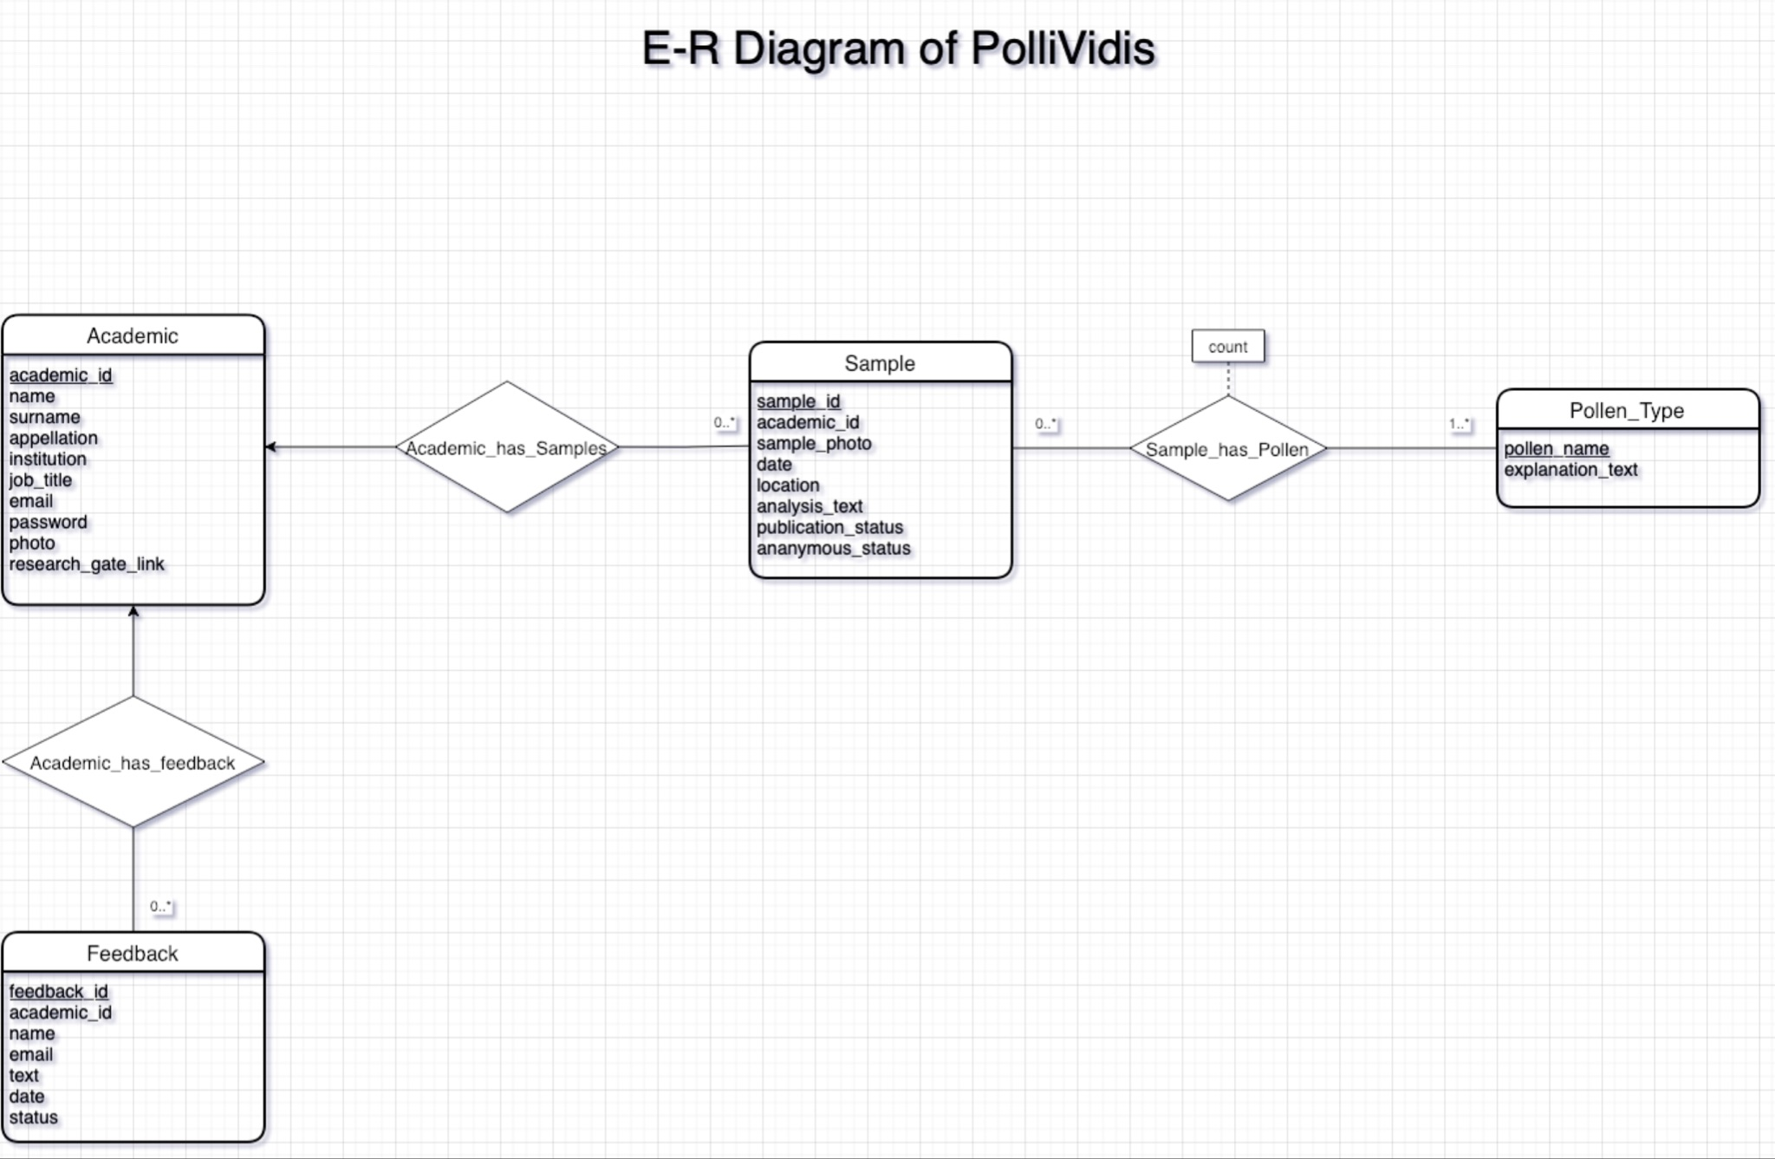
Database
MySQL based relational database running on Dijkstra.
Holds samples, academic users, pollen types, and user feedbacks.
Controlled by Database Manager.
Notes:
MySQL based database
Python models for ease of use
Database Manager

Slide 23
What Will be Done
CNN model will be improved and optimized with more samples and experiments with hyperparameters.
Remaining pollen species will be collected for the dataset.
Remaining pages and functionalities such as Login, Sign-Up, Previous Analyses, Feedback, and Search will be implemented and connected with back-end.
UI Design will be improved.

Slide 24
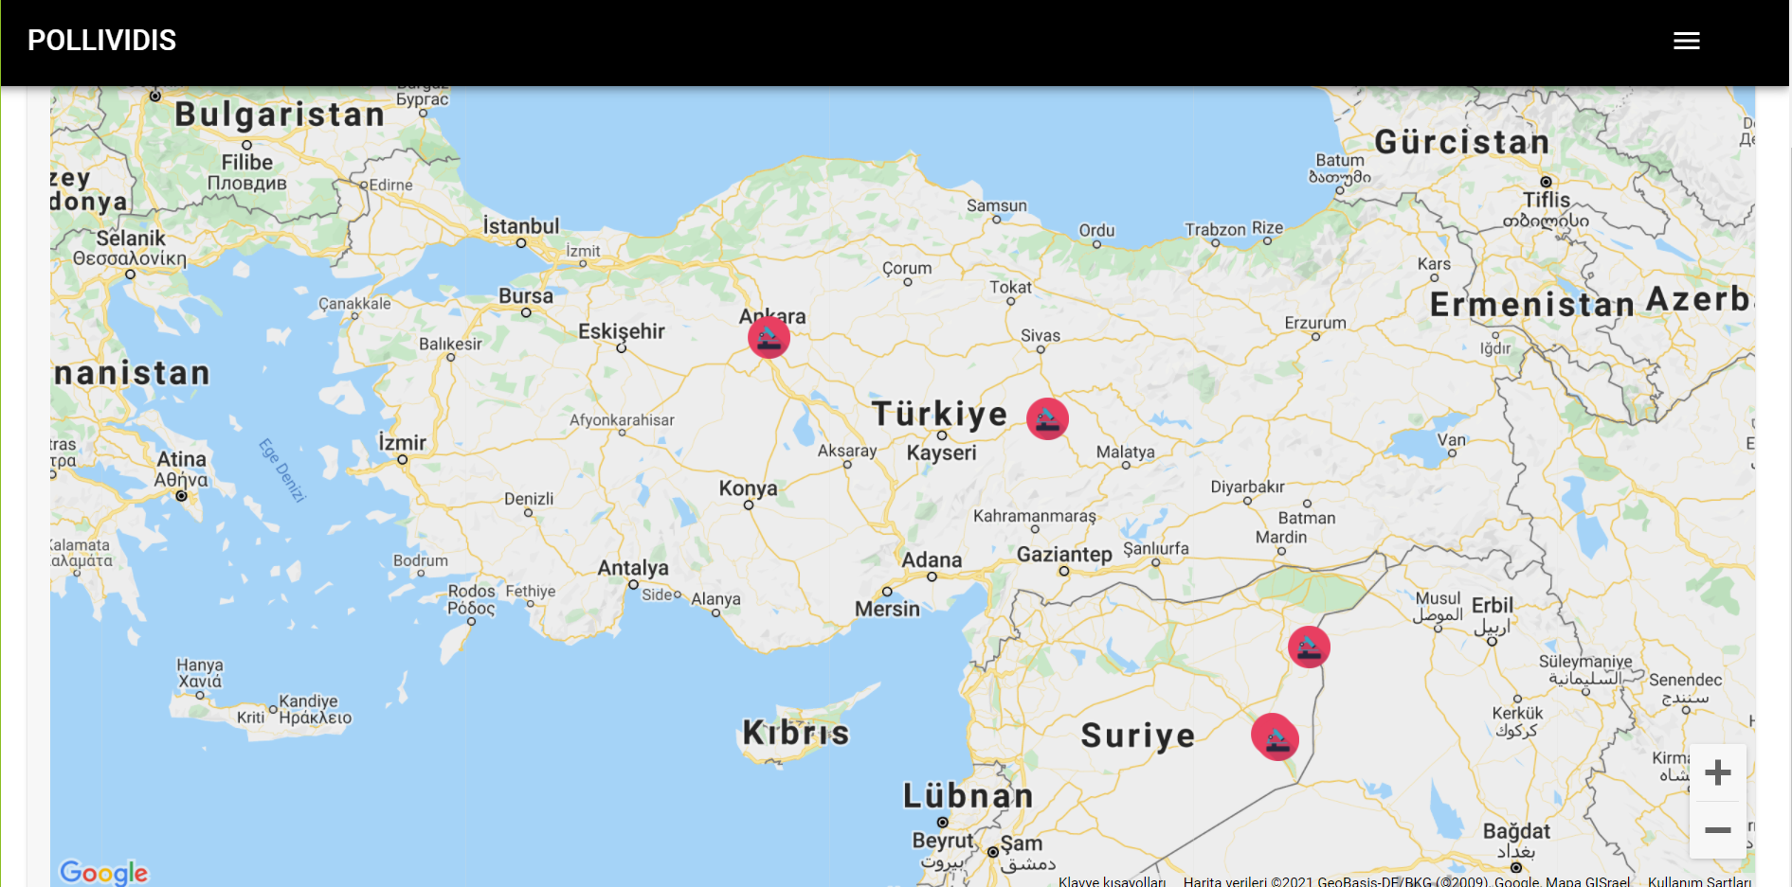
The Pollen Map
Google Maps based interactive pollen map.
Markers represent pollen sample analyses from the database.

Slide 25
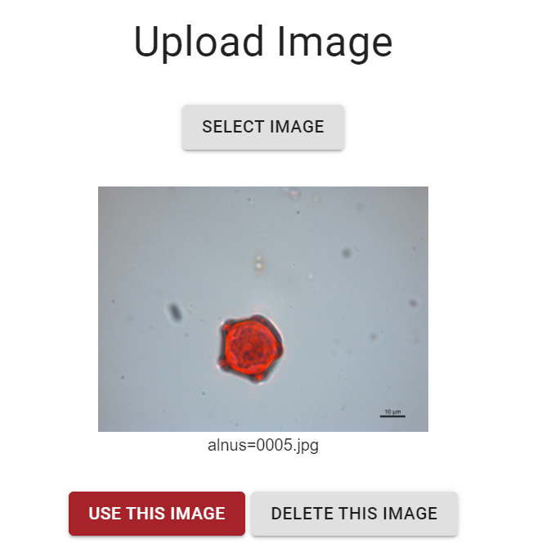
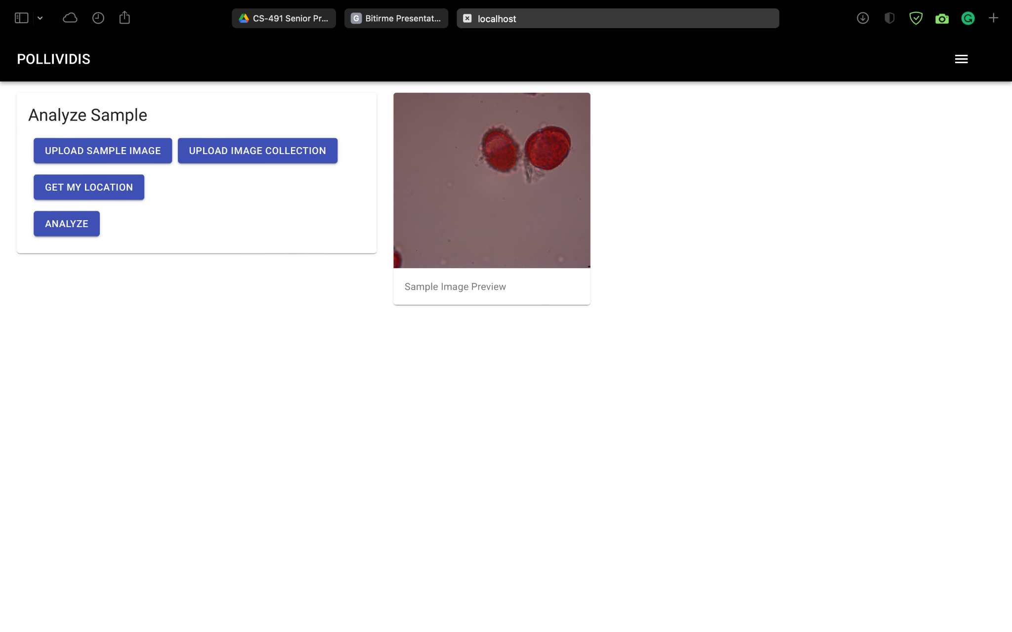
Analyze Sample
Users can analyze their pollen samples by uploading the images to PolliVidis.

Slide 26
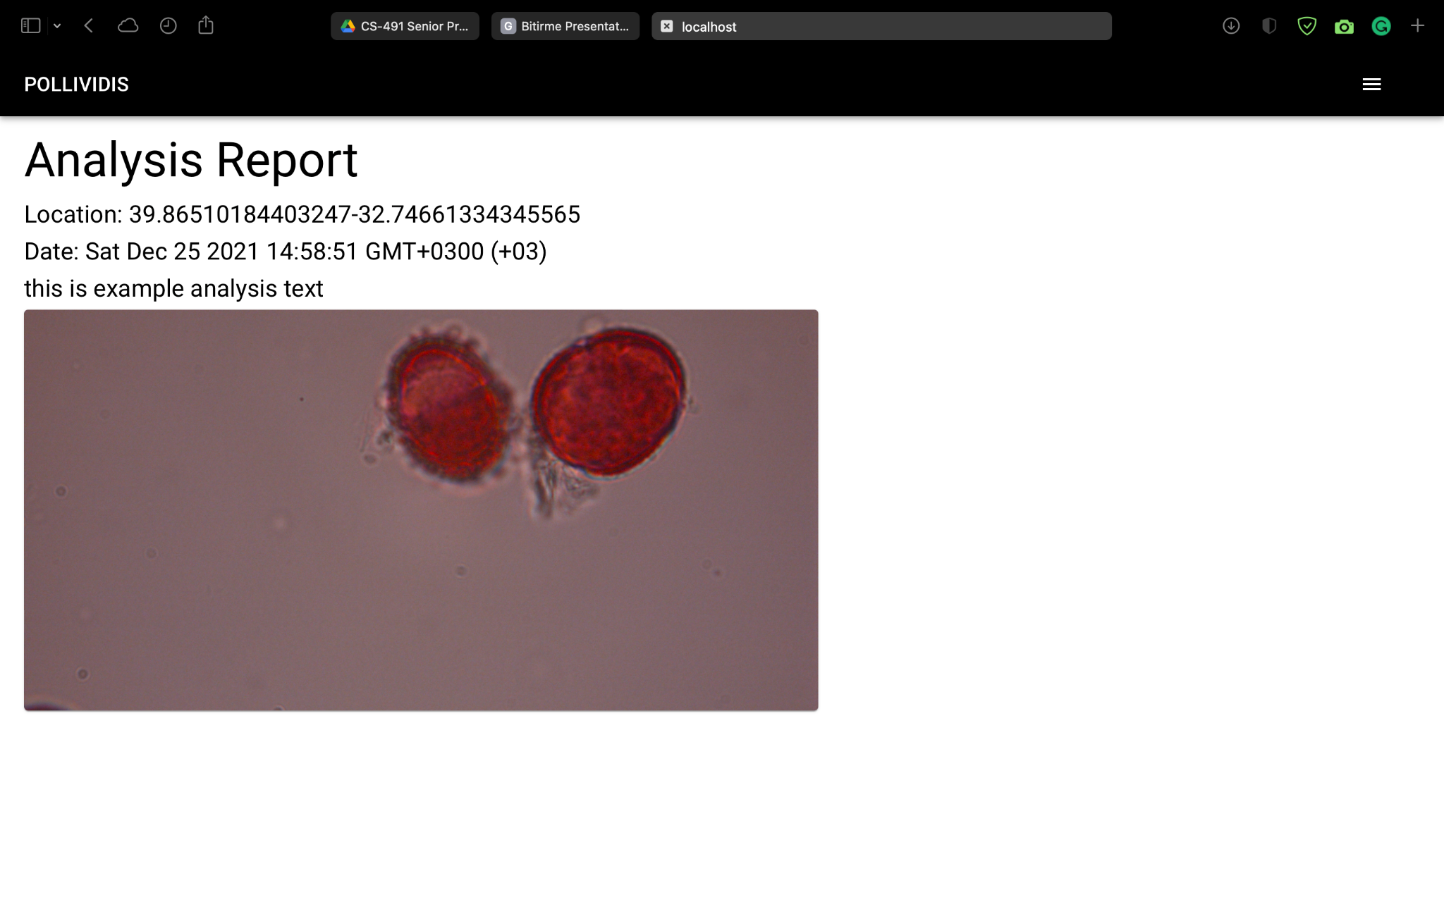
Analysis Report
PolliVidis generates an analysis report from user’s sample by classifying it with the ML model.

Slide 27
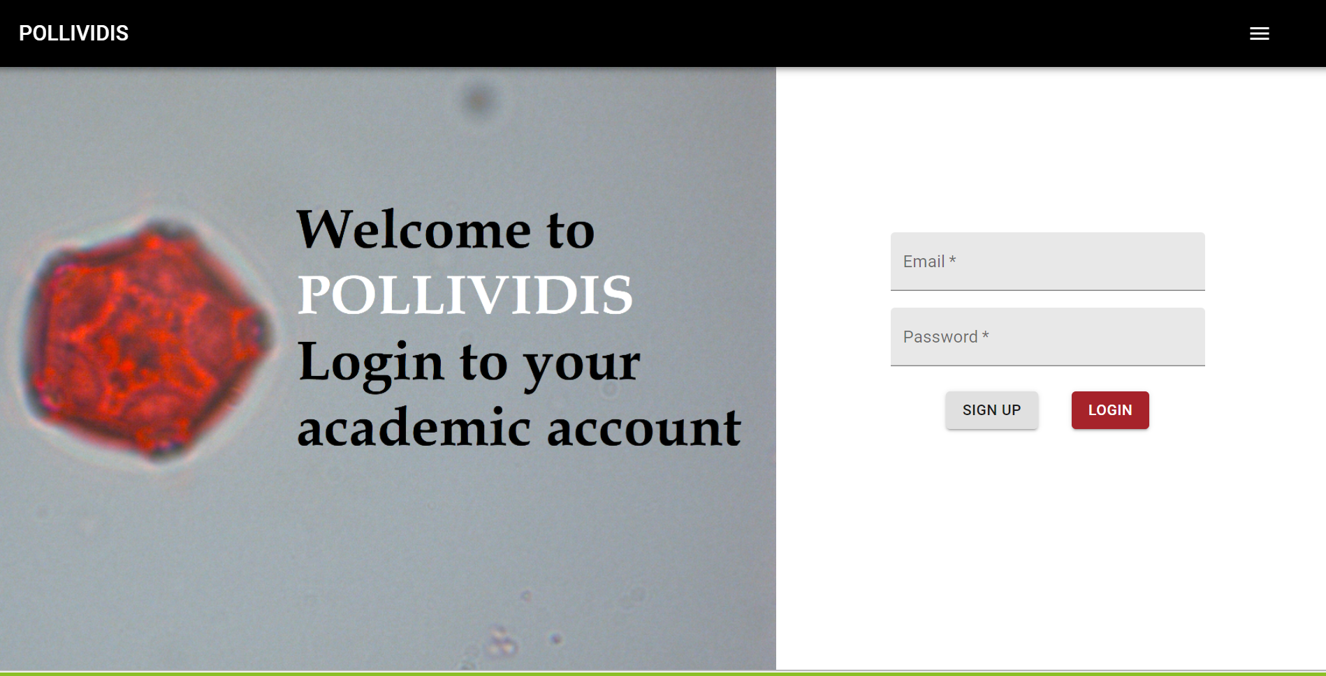
Academic User
Unlike other users, academics can update the Pollen Map by uploading samples.
Academic users must sign-up and login-in to PolliVidis in order to update the Pollen Map.

Slide 28
Problem Definition
Identification and classification of pollen species is a tedious job and requires trained eyes of palynologists.
Currently, there is no available ML model for academics to use for pollen classification with light microscopy samples.
There is no global database where academics can store and share their pollen samples.
A pollen map that shows the pollen analyses, pollen diversity with densities is needed, so that allergic people can take precautions.

Slide 29
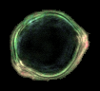
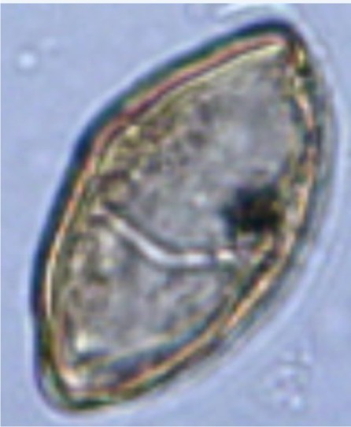
The Dataset Problem
For our model, we conducted a detailed research about existing pollen datasets.
However available datasets did not meet our standards.
Not enough number of samples
choice of microscope
poor quality of sampling…
Classifinder Dataset Example
POLEN23E Dataset Example

Slide 30
Purpose of Pollividis
Developing an Image Processing Procedure
to extract single pollen images from a sample image.
Developing an Deep Learning Architecture to classify and count pollen samples.
Creating a Web Application:
which offers a database where scientists can store and share their classified samples.
which shows the contents of this database as a Pollen Map so that people with pollen allergies can take measures against it.

Slide 31
The Procedure

Slide 32
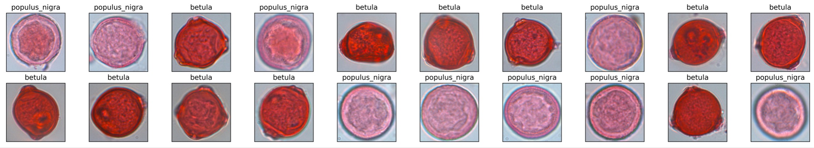
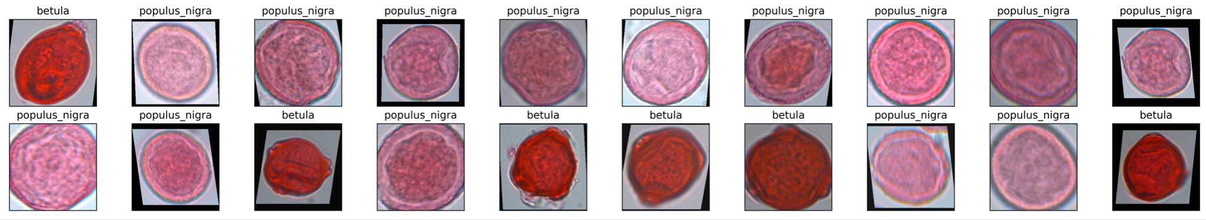
Data Augmentation (Dataset Pre-Processing for CNN)
Random Horizontal and Vertical Flip
Random Affine
Color Jitter
Dataset without
Data Augmentation
Dataset with
Data Augmentation
Notes:
augmentation types
add image

Slide 33
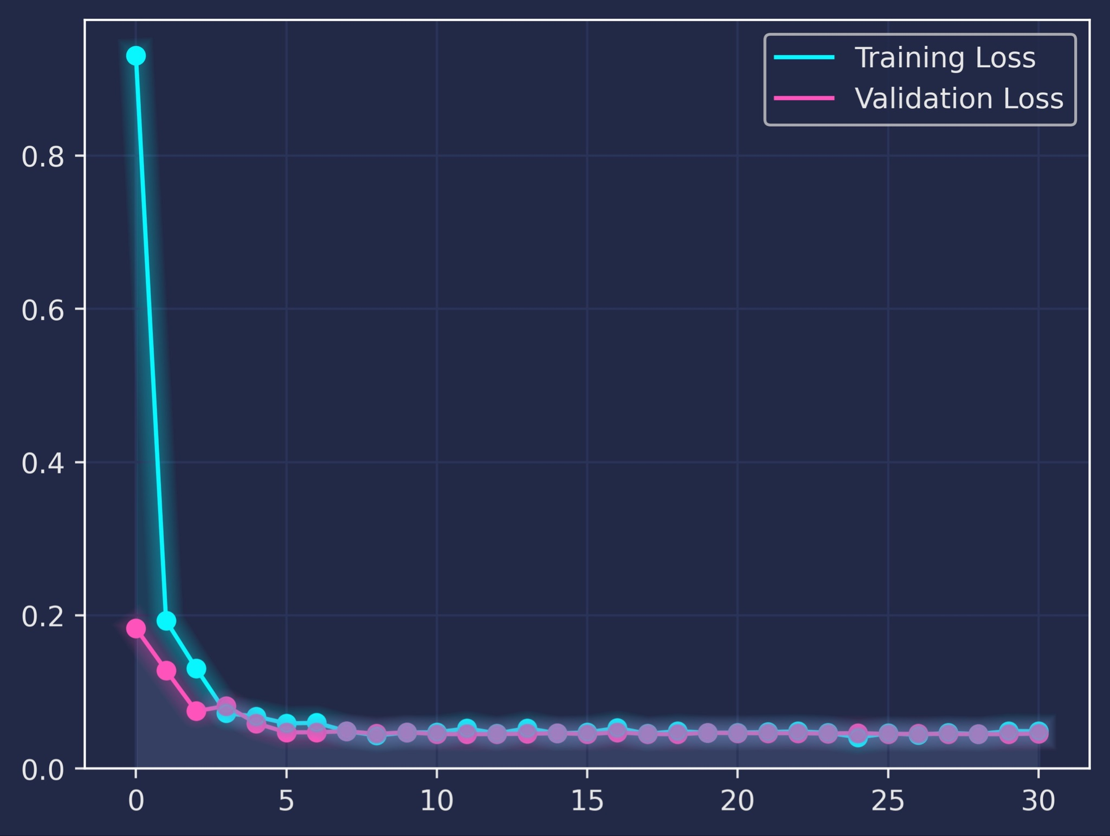
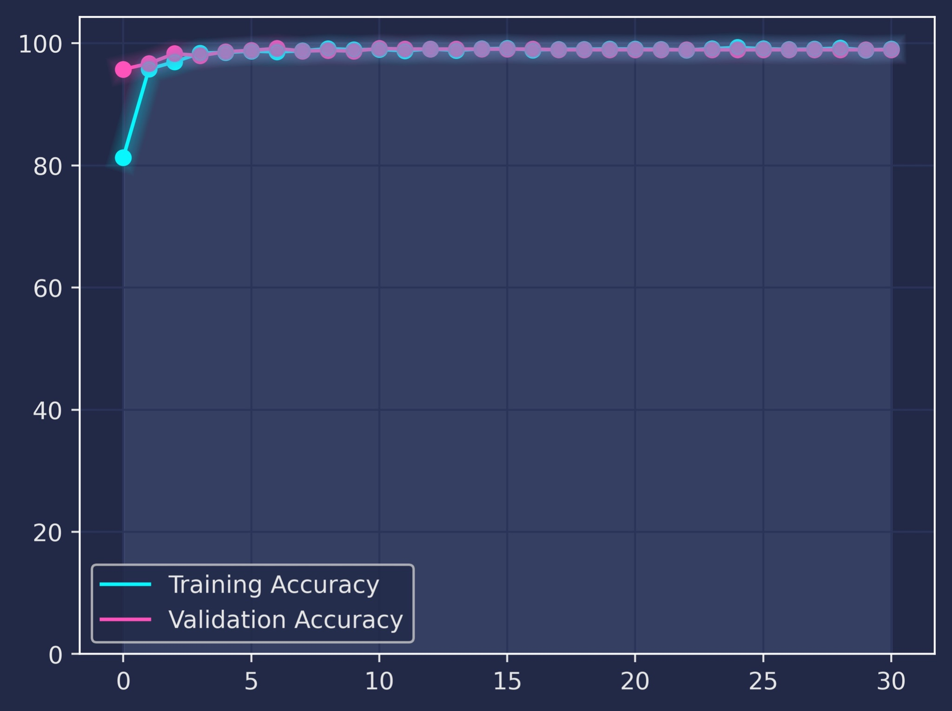
CNN Loss and Accuracy
Fine-Tuning the following hyperparameters of CNN
Learning Rate
Epoch
Batch Size
Step Size (Scheduler)
Gamma (Schedular)
Dataset Split Ratio
Notes:
AlexNet image (half freezed)

Slide 34
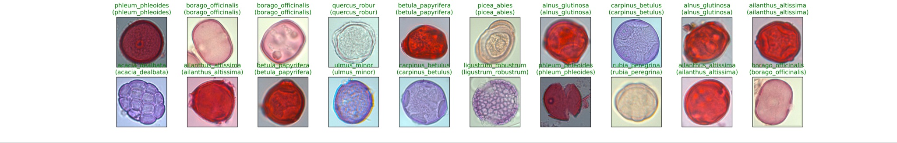
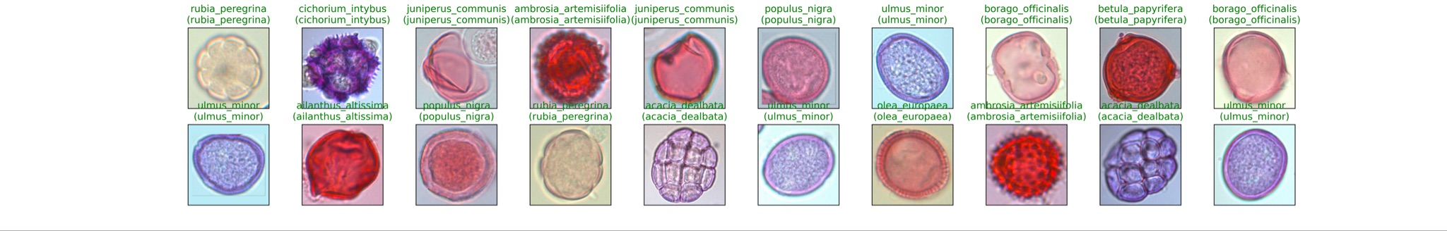
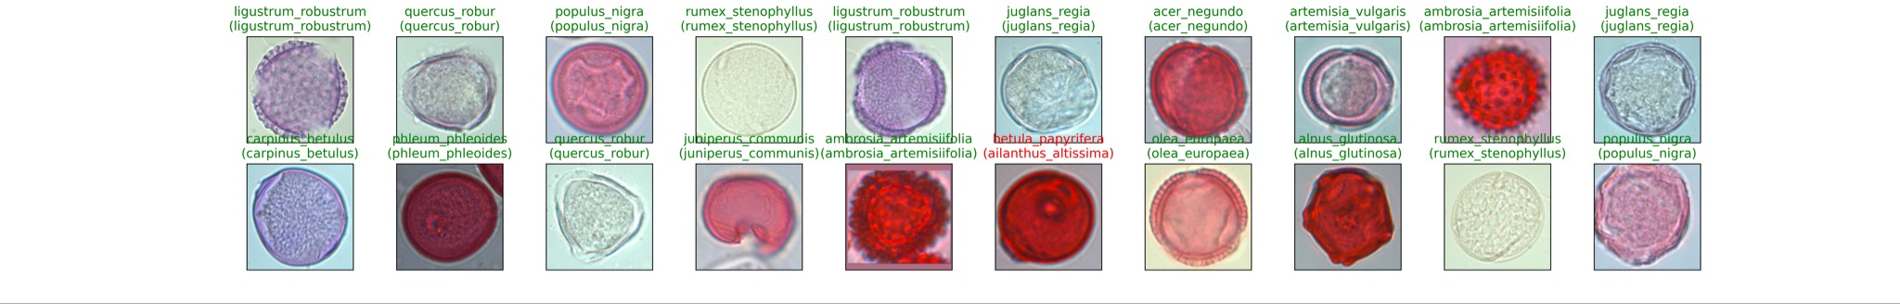
CNN Testing Examples
Notes:
AlexNet image (half freezed)

Slide 35
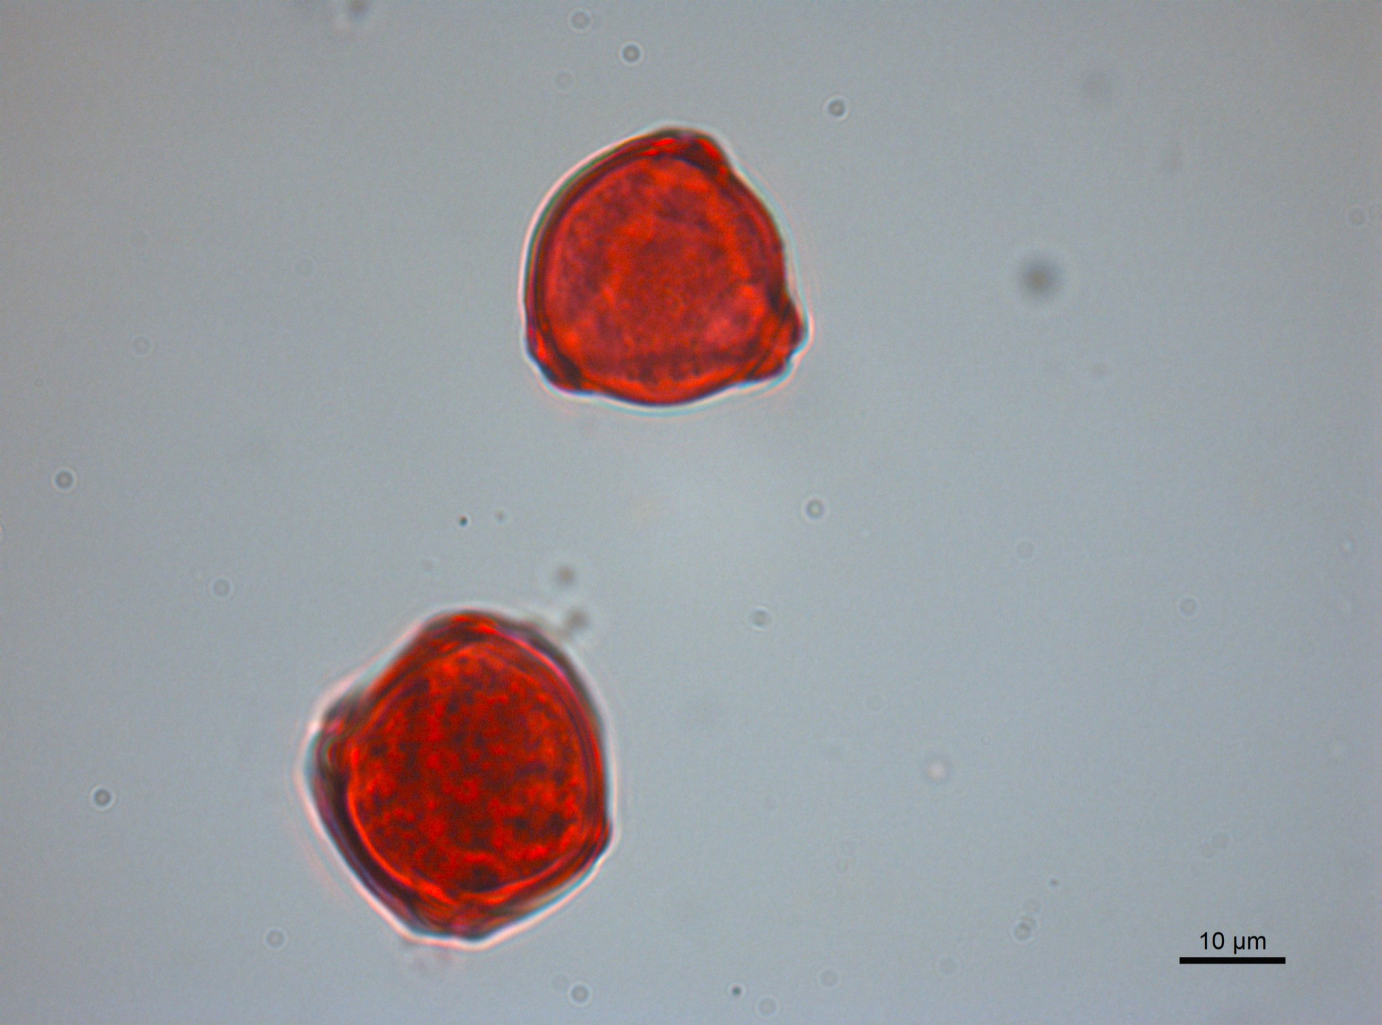
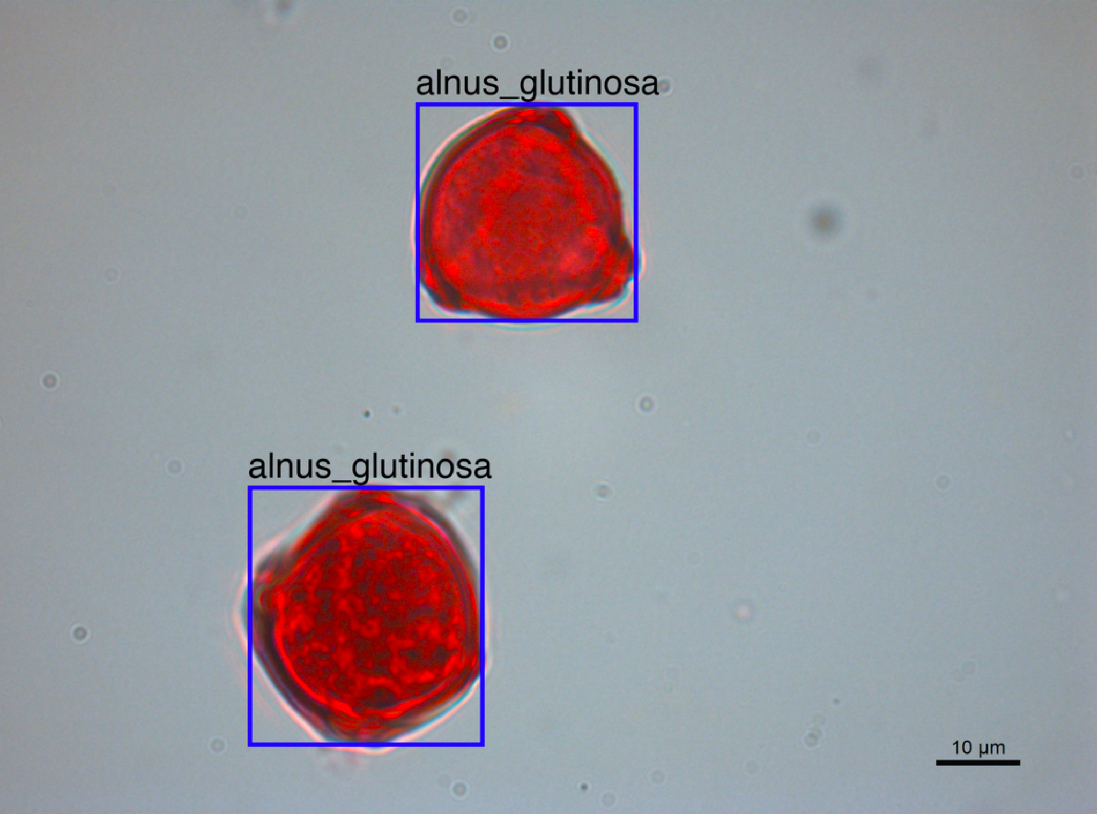
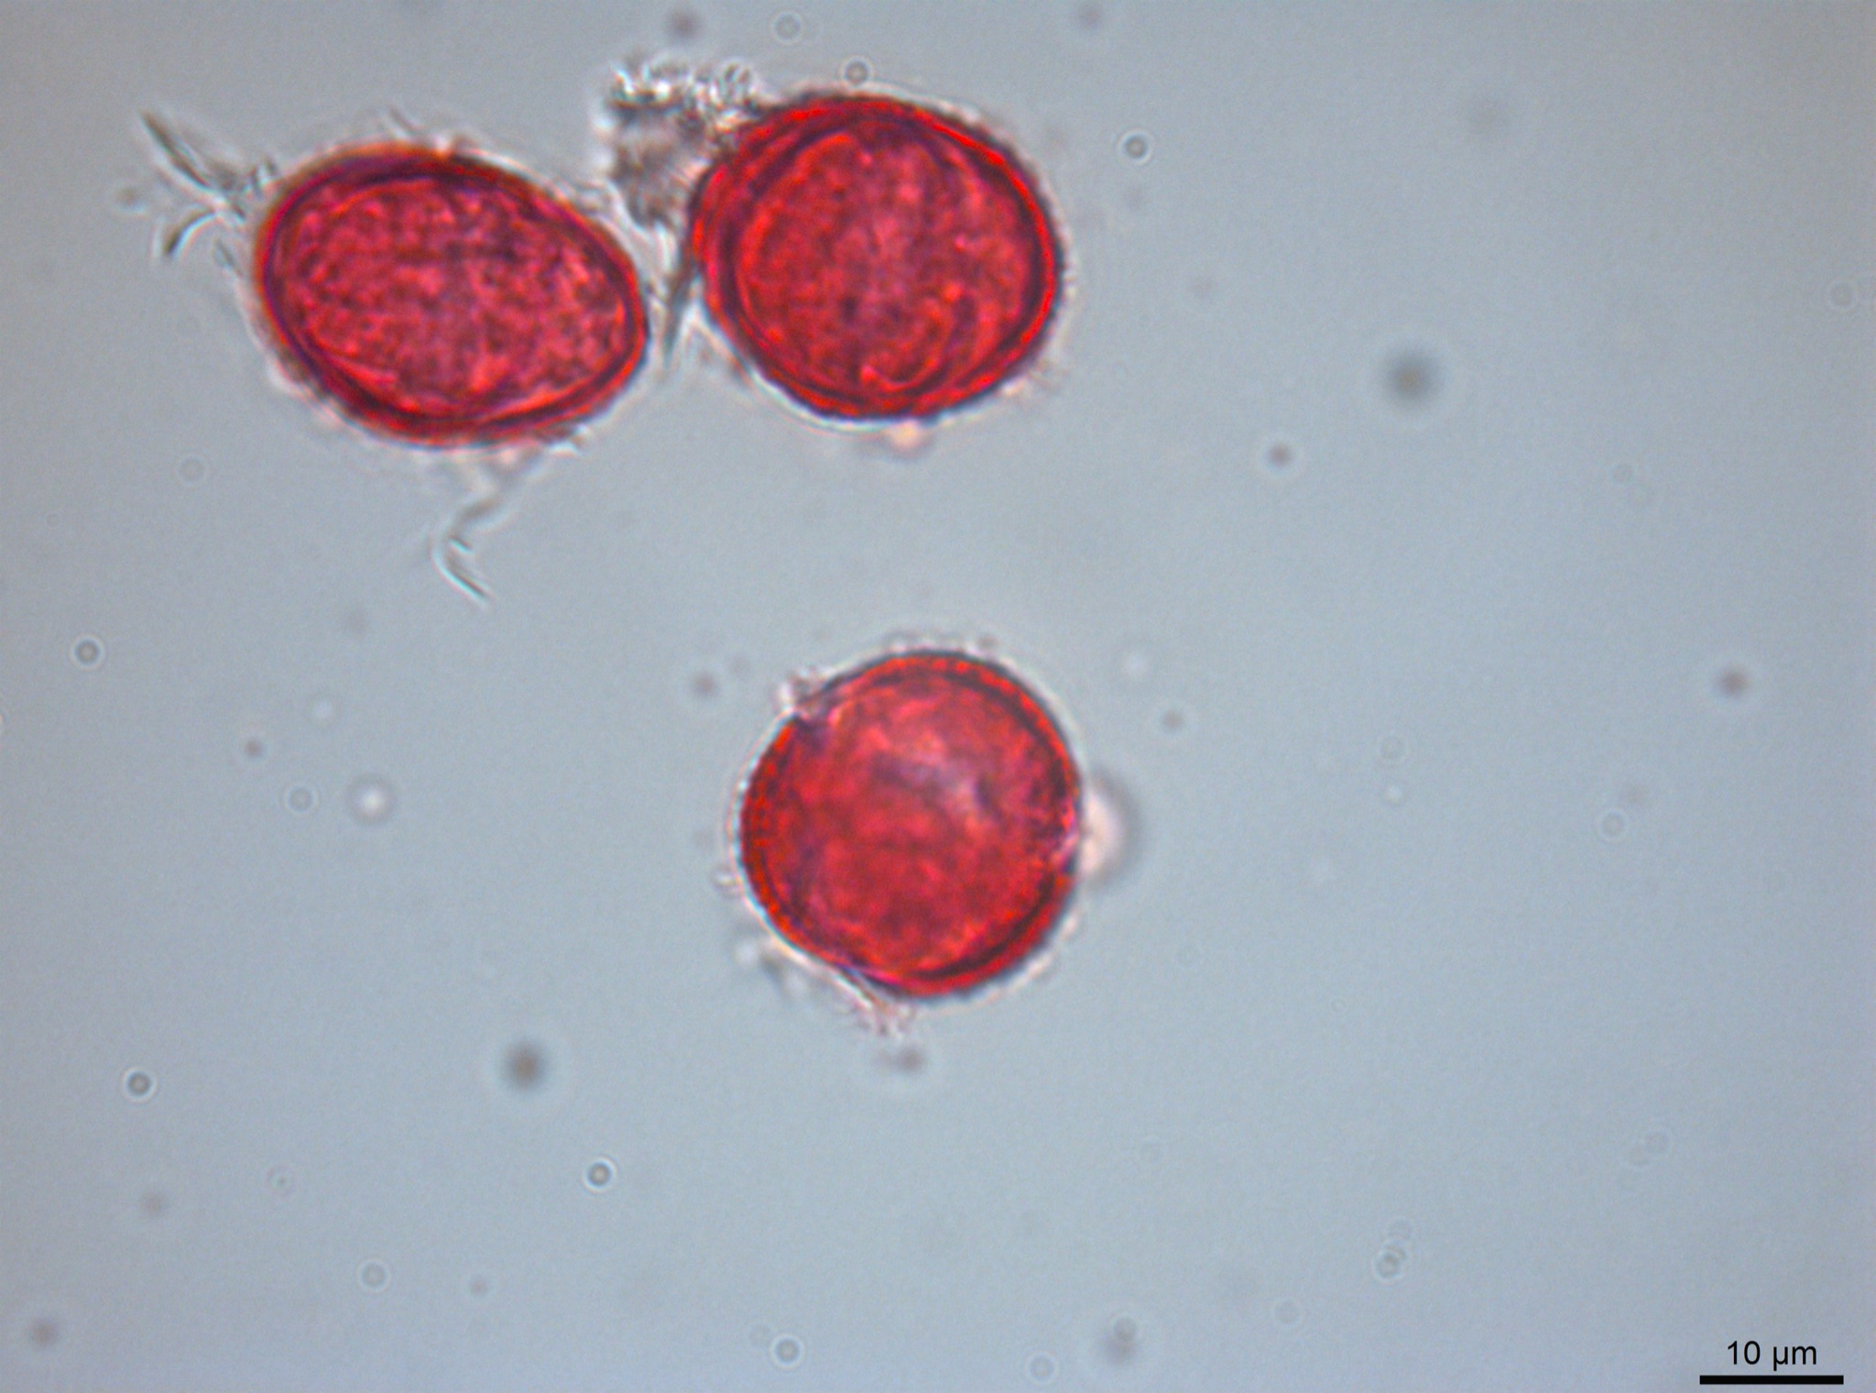
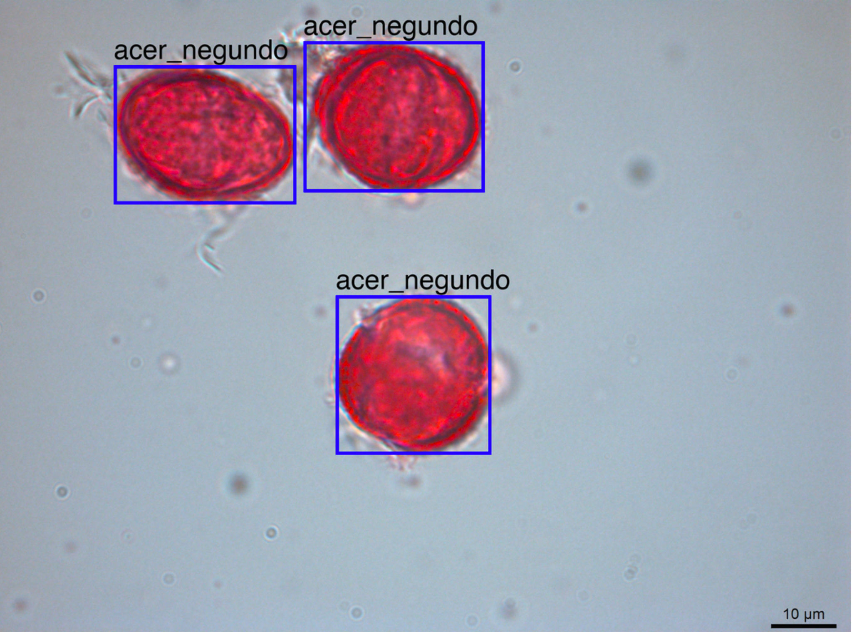
CNN
Analysis
Examples
Notes:
AlexNet image (half freezed)

Slide 36
Morphology Sequence
Only Non-Trivial User Supplied Parameter for Image Processing Procedure
Sequence of Morphology Operations,
Dilation
Erosion
Closing
Opening
Area Closing
Area Opening
Automatic Mode (single integer) applies
multi erosion -> multi dilation -> area closing
Manual Mode (E12-D12-AC100000) for advance sequences.
Notes:
AlexNet image (half freezed)

